Slide 1
Colors
Black
PMS Pantone Black
CMYK 0-0-0-100
RGB 0-0-0
HEX #000000
Aqua
PMS 7474 CP
CMYK 96-9-32-29
RGB 0-123-140
HEX #007B8C
Red
PMS 186
CMYK 0-100-81-4
RGB 204-9-47
HEX #CC092F
Dark Gray
PMS Cool Gray 11
CMYK 0-0-0-80
RGB 83-86-90
HEX #53565A
White
CMYK 0-0-0-0
RGB 255-255-255
HEX #FFFFFF
Purple
PMS 7678 C
CMYK 74-85-0-0
RGB 108-75-148
HEX #6C4B94
Orange
PMS 138 CP
CMYK 0-52-100-0
RGB 230-140-40
HEX #E68C28
Cool Gray 7
PMS Cool Gray 7
CMYK 0-0-0-48
RGB 151-153-155
HEX #97999B
Dark Blue
PMS 4146
CMYK 100-82-0-81
RGB 27-29-54
HEX #1B1D36
Azure
PMS 313 CP
CMYK 100-0-11-2
RGB 0-152-199
HEX #0098C7
(AA Compliant)
RGB 0-125-163
HEX #007DA3
Yellow
PMS 7408 CP
CMYK 0-29-100-0
RGB 243-186-22
HEX #F3BA16
Broadcom Gray
CMYK 0-0-0-12
RGB 226-227-228
HEX #E2E3E4
Blue
PMS 7469 C CMYK 96-64-24-6 RGB 0-92-138 HEX #005C8A
Green
PMS 369 C
CMYK 67-12-100-1
RGB 97-166-14
HEX #61A60E
(AA Compliant)
RGB 35-128-10
HEX #23800A

Slide 2
VCF Low Level Design Diagrams

Slide 3
VCF Constructs v1
VCF Private Cloud
VCF Fleet
VCF Fleet
VCF Operations
VCF Operations
VCF Automation
VCF Automation
VCF Instance
VCF Instance
Management Domain
Management Domain
vCenter
vCenter
NSX
NSX
SDDC Manager
SDDC Manager
Workload Domains
Workload Domains
Additional VCF Instances
Additional VCF Instances

Slide 4
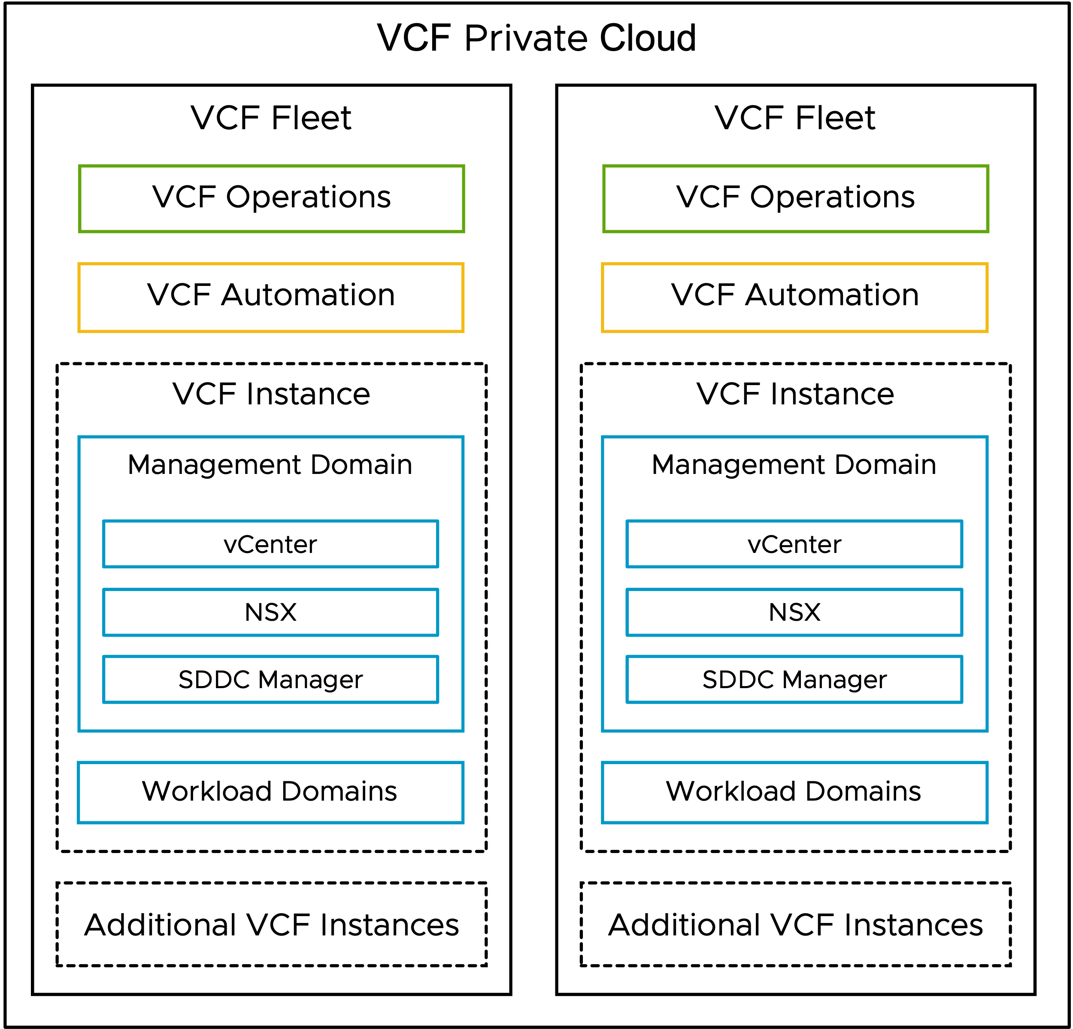
VCF Constructs v1 (SVG Image)

Slide 5
vSphere Cluster Models

Slide 6
vSphere Cluster Models v1
Single Rack
Multi-Rack
Stretched
VCF Instance
Availability Zone 1
Availability Zone 2
Rack
Rack
Rack
Rack
Workload Domain 1
Single Rack Cluster
Single Rack Cluster
Workload Domain 2
Single Rack Cluster
Multi Rack Cluster
Single Rack Cluster
Stretched Cluster
Workload Domain 3
Storage Cluster
Compute Cluster
Storage Cluster
Compute Only

Slide 7
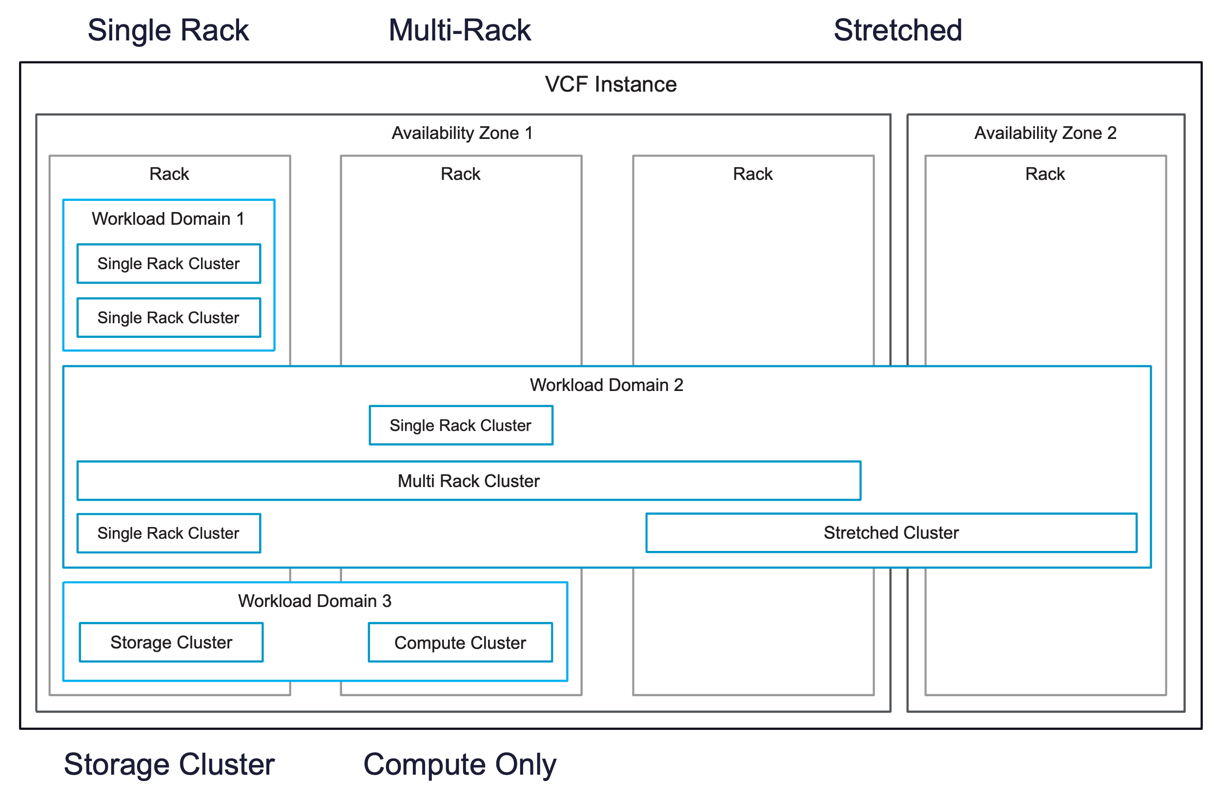
vSphere Cluster Models v1(SVG Image)

Slide 8
VCF Operations Models

Slide 9
VCF Operations Models v1
Simple - VCF Operations
High Availability - VCF Operations
VCF Operations
VCF Instance Account
VCF Operations
VCF Operations
(Fleet Management)
Management Domain
VCF Operations
(Fleet Management)
VCF Operations
Primary node
vCenter Adapter
VCF Operations
Primary node
vSAN Adapter
VCF Instance Account
NSX Adapter
Management Domain
VCF Operations
Replica node
vCenter Adapter
Workload Domain
VCF Operations
Data node
vSAN Adapter
vCenter Adapter
NSX Adapter
VCF Operations Collectors
vSAN Adapter
VCF Operations
Collector node
NSX Adapter
Workload Domain
vCenter Adapter
VCF Operations Collectors
vSAN Adapter
VCF Operations
Collector node
NSX Adapter

Slide 10
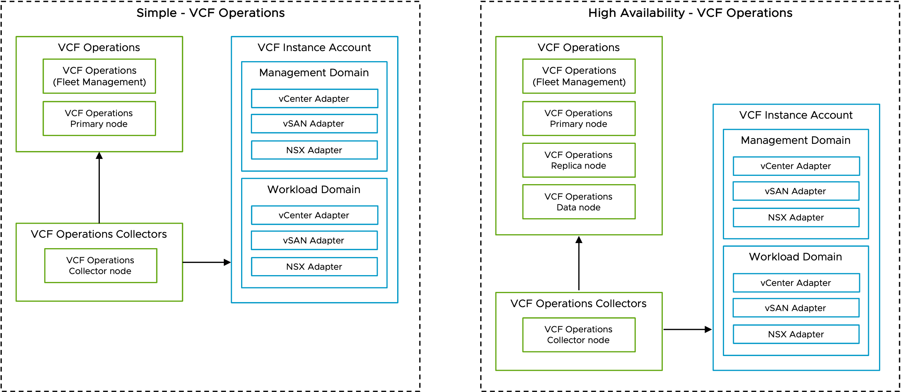
VCF Operations Models v1 (SVG Image)

Slide 11
VCF Operations for Logs Models

Slide 12
VCF Operations for Logs Models v1
Simple - VCF Operations for Logs
High Availability - VCF Operations for Logs
VCF Operations
VCF Operations
VCF Operations
VCF Operations
(Fleet Management)
VCF Operations
Collector node
VCF Operations
VCF Operations
(Fleet Management)
VCF Operations
Collector node
VCF Operations for Logs
VCF Operations for Logs
Internal Load Balancer
Internal Load Balancer
VCF Operations for Logs
VCF Operations for Logs
VCF Operations for Logs
VCF Operations for Logs
VCF Instance
VCF Instance
Management Domain
Workload Domain
Management Domain
Workload Domain
vCenter
vCenter
vCenter
vCenter
NSX Manager
NSX Manager
NSX Manager
NSX Manager
SDDC Manager
SDDC Manager

Slide 13
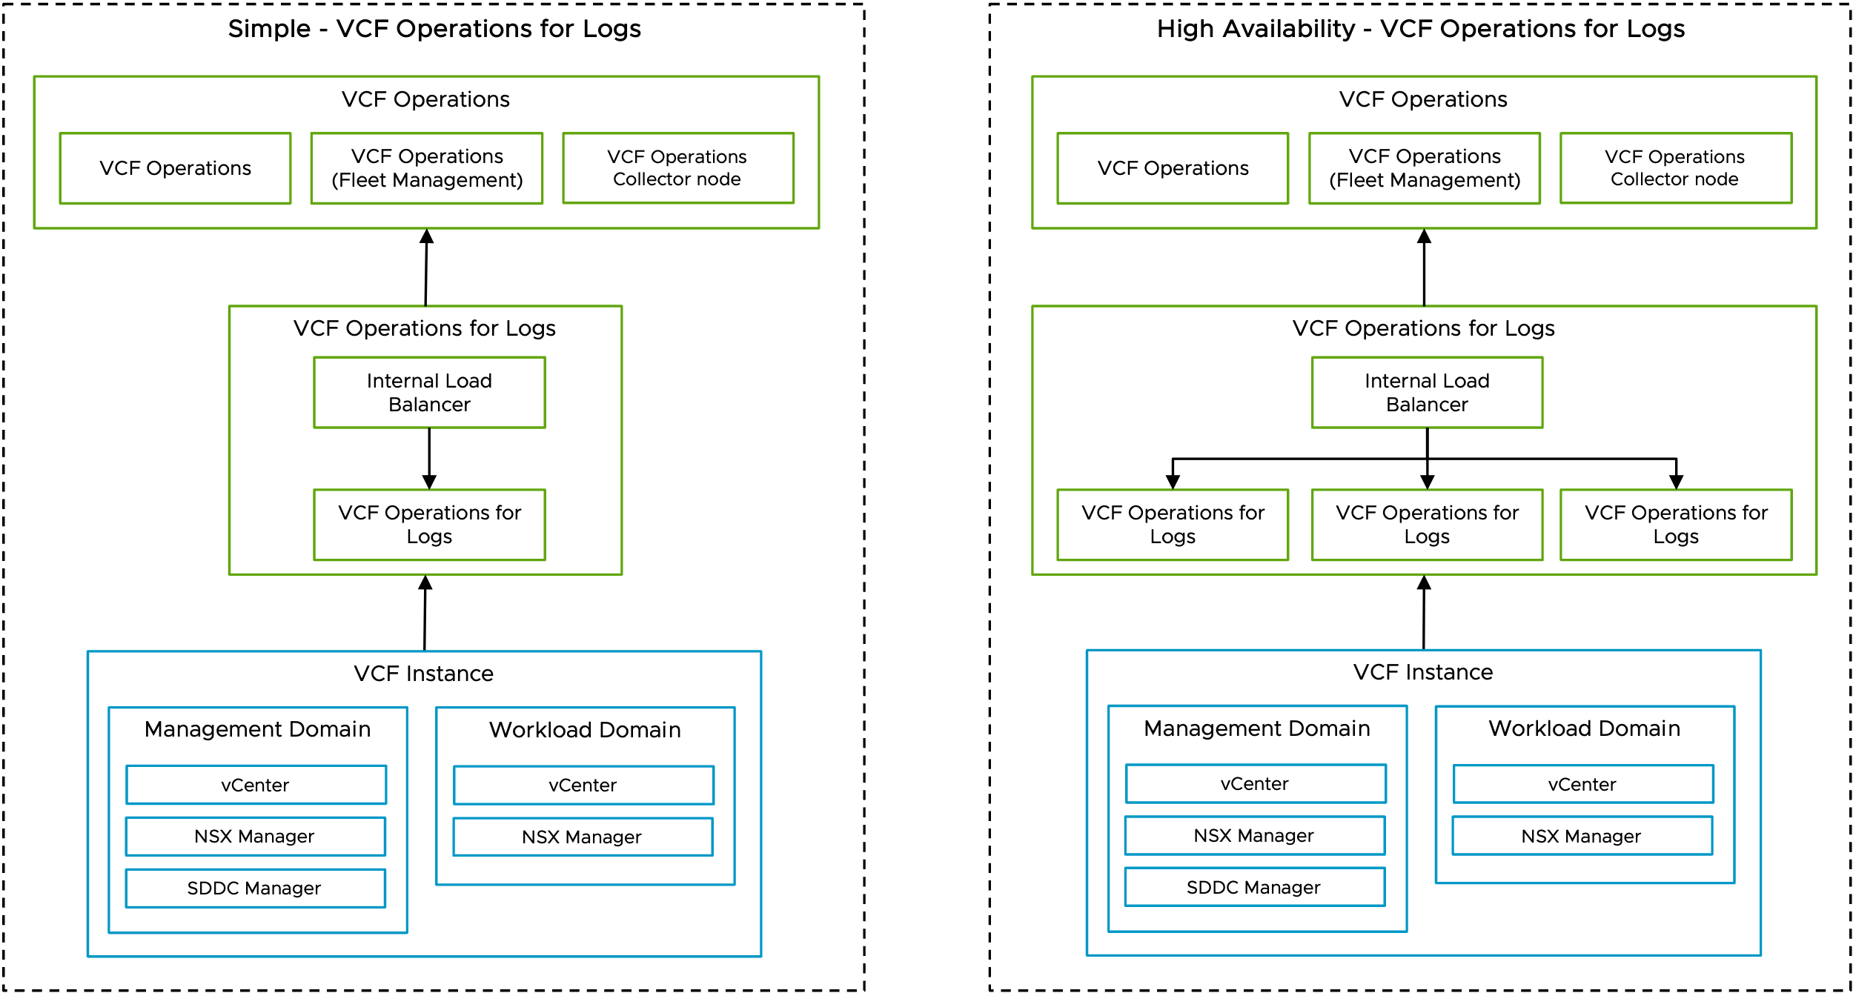
VCF Operations for Logs v1 (SVG Image)

Slide 14
VCF Operations for Networks Models

Slide 15
VCF Operations for Networks Models v1
Simple - VCF Operations for Networks
High Availability - VCF Operations for Networks
VCF Operations
VCF Operations
VCF Operations
VCF Operations
(Fleet Management)
VCF Operations
Collector node
VCF Operations
VCF Operations
(Fleet Management)
VCF Operations
Collector node
VCF Operations for Networks
VCF Operations for Networks
VCF Operations for Networks
Platform Node
VCF Operations for Networks
Collector Node
Cluster
VCF Operations for Networks
Platform Node
VCF Operations for Networks
Platform Node
VCF Operations for Networks
Platform Node
VCF Instance
VCF Operations for Networks
Collector Node
Management Domain
Workload Domain
vCenter
vCenter
NSX Manager
NSX Manager
VCF Instance
SDDC Manager
Management Domain
Workload Domain
vCenter
vCenter
NSX Manager
NSX Manager
SDDC Manager

Slide 16
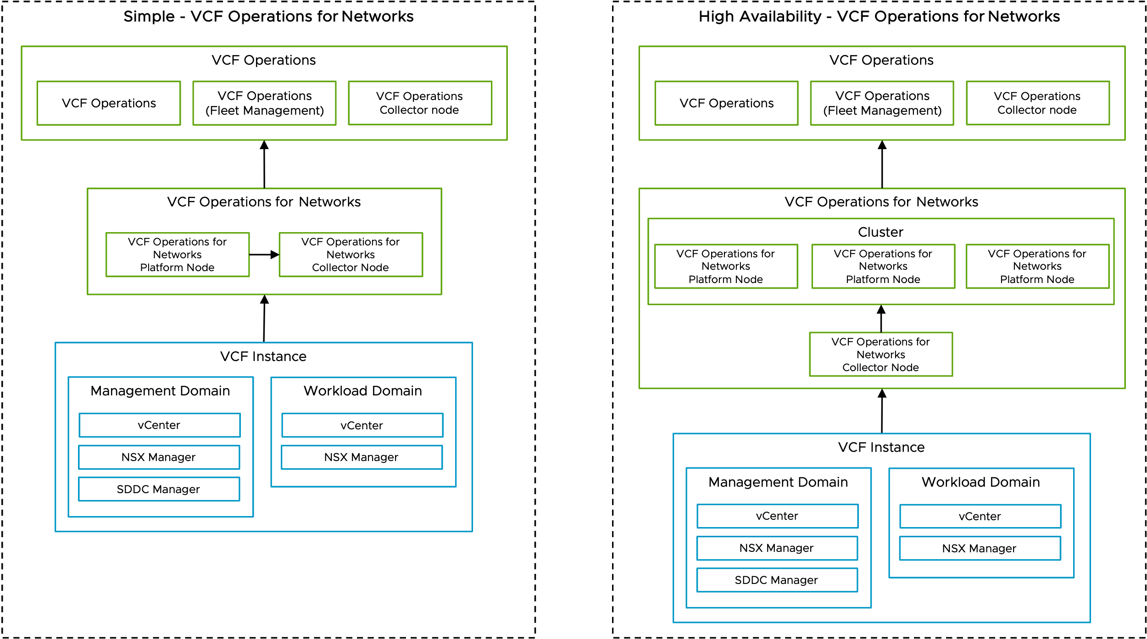
VCF Operations for Networks v1 (SVG Image)

Slide 17
VCF Automation Models

Slide 18
VCF Automation Models v1
Simple - VCF Automation
High Availability - VCF Automation
VCF Automation
VCF Automation
Native Load Balancer
Native Load Balancer
VCF Automation
(Node 1)
VCF Automation
(Node 1)
VCF Automation
(Node 2)
VCF Automation
(Node 3)
Connections
Connections
Management Domain
Workload Domain
Management Domain
Workload Domain
vCenter
vCenter
vCenter
vCenter
NSX Manager
NSX Manager
NSX Manager
NSX Manager

Slide 19
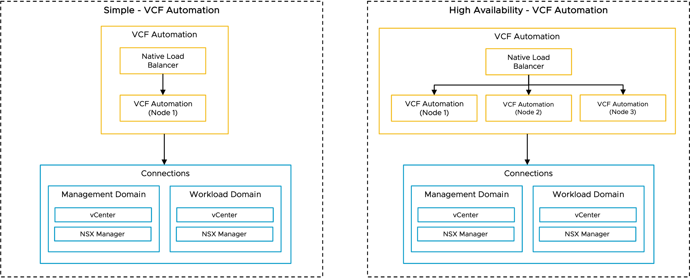
VCF Automation Models v1 (SVG Image)

Slide 20
VCF Simple and HA Models Combined v2
Simple – VCF Automation
High Availability – VCF Automation
VCF Automation
VCF Automation
Native Load Balancer
Native Load Balancer
VCF Automation (Node 1)
VCF Automation (Node 1)
VCF Automation (Node 2)
VCF Automation (Node 3)
Management Domain
Workload Domain
Management Domain
Workload Domain
vCenter
vCenter
vCenter
vCenter
NSX Manager
NSX Manager
NSX Manager
NSX Manager

Slide 21
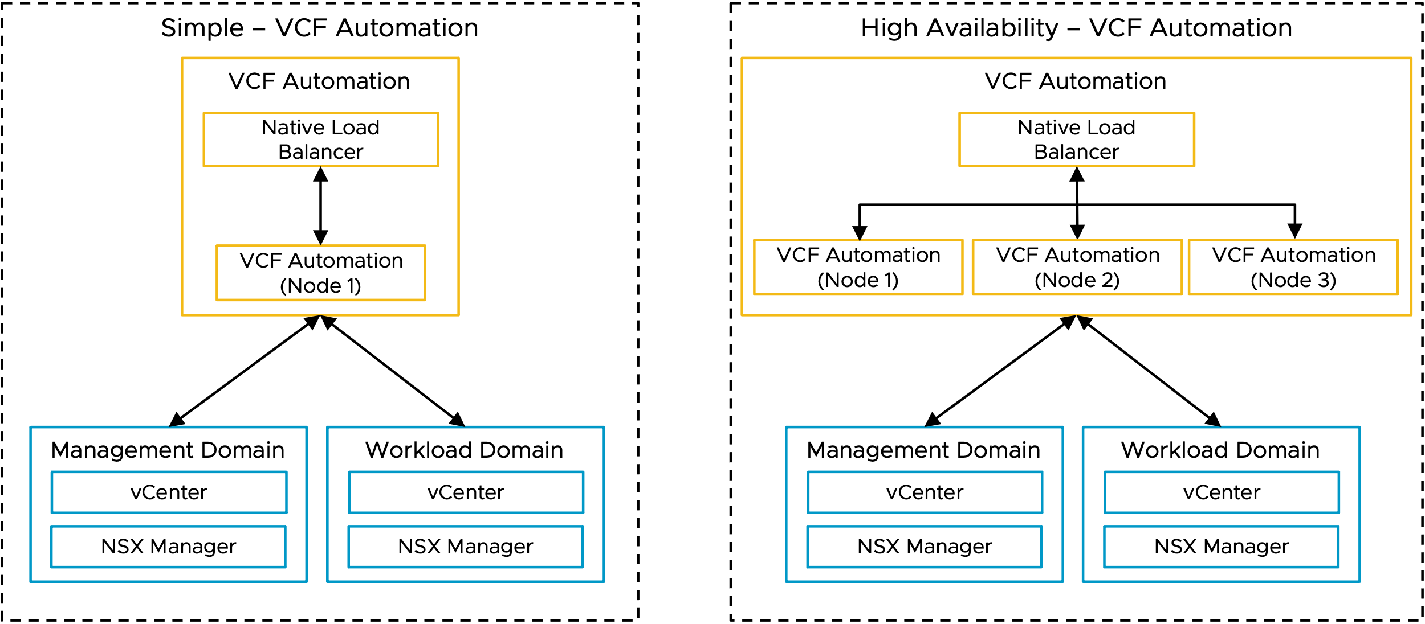
VCF Simple and HA Models Combined v2 (SVG Image)

Slide 22
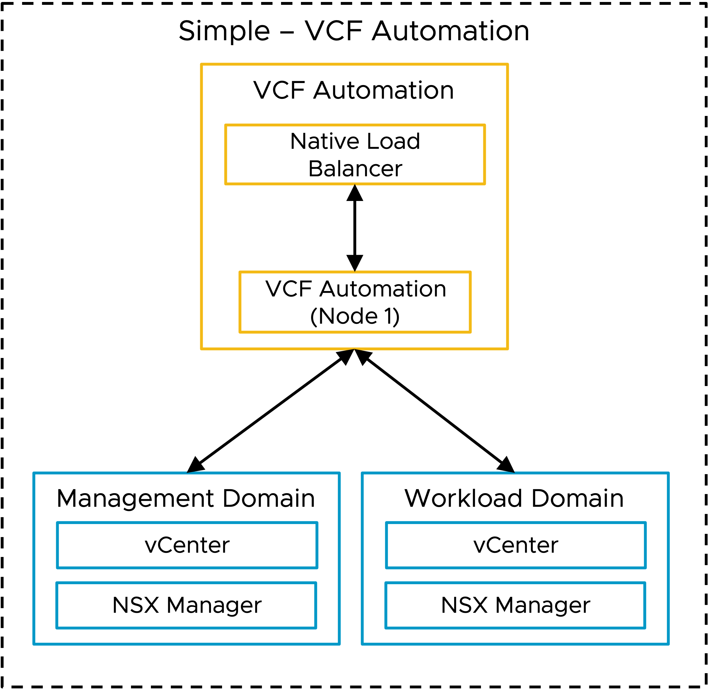
VCF Simple Model (SVG Image)

Slide 23
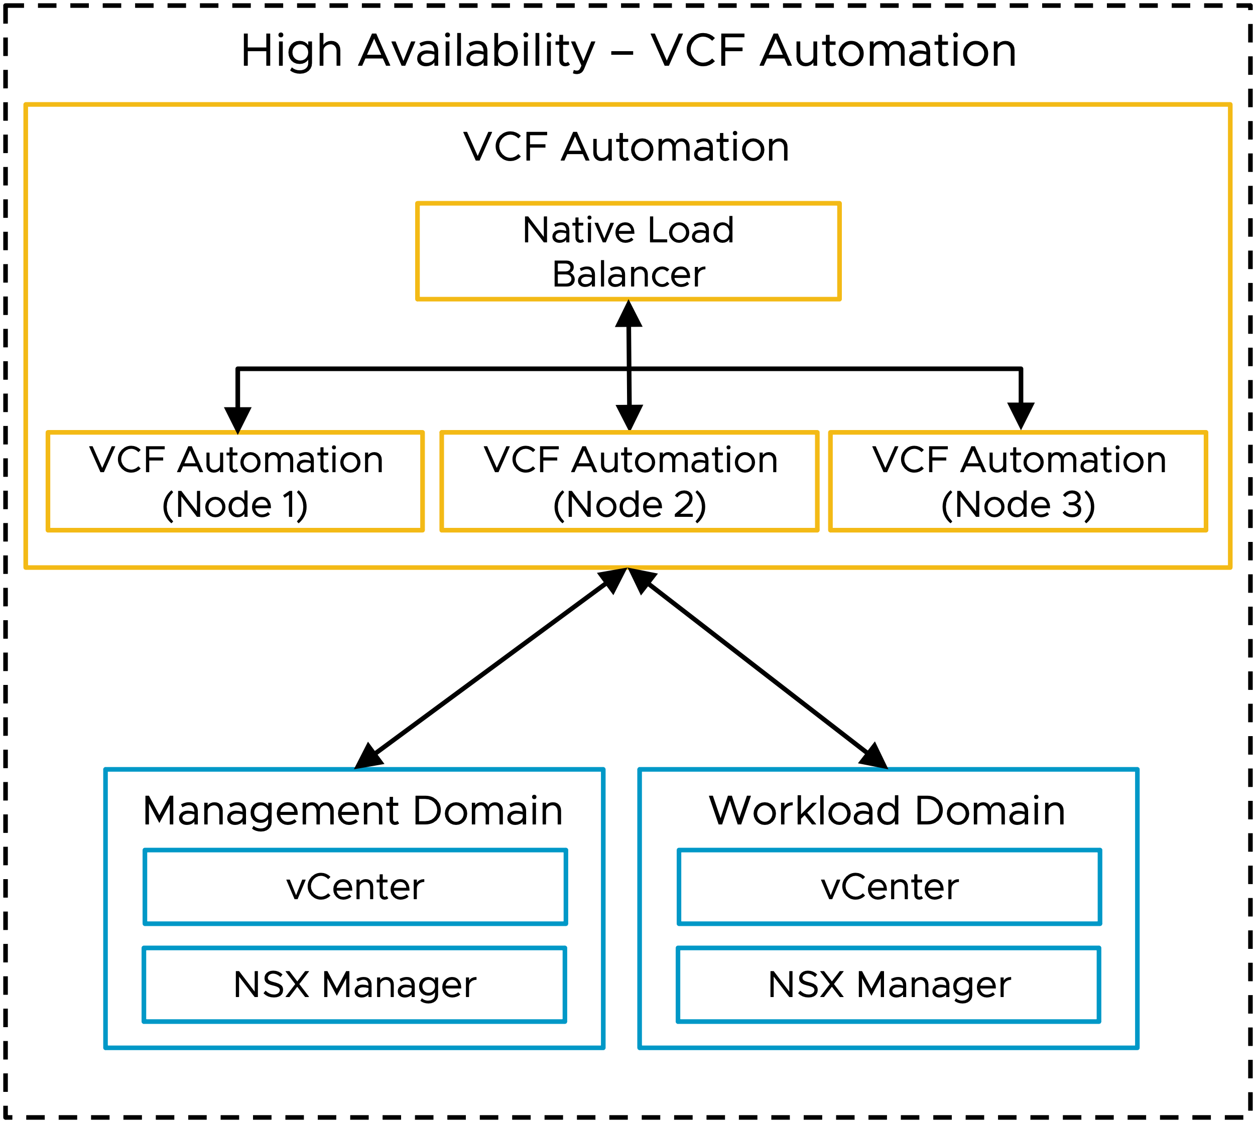
VCF HA Model v2 (SVG Image)

Slide 24
VCF Simple and HA Models Combined w/ External LB v2
Simple – VCF Automation
High Availability – VCF Automation
VCF Automation
VCF Automation
External Load Balancer (Optional)
External Load Balancer (Optional)
Native Load Balancer
Native Load Balancer
VCF Automation (Node 1)
VCF Automation (Node 1)
VCF Automation (Node 2)
VCF Automation (Node 3)
Management Domain
Workload Domain
Management Domain
Workload Domain
vCenter
vCenter
vCenter
vCenter
NSX Manager
NSX Manager
NSX Manager
NSX Manager

Slide 25
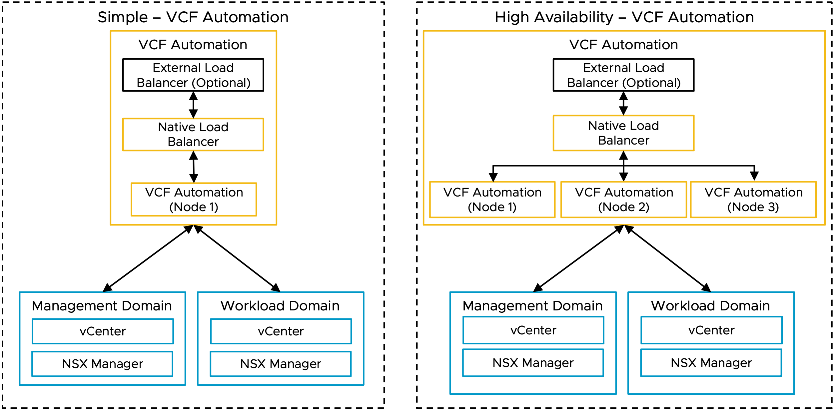
VCF Simple and HA Models Combined w/ External LB (SVG Image)

Slide 26
VCFA Object Flow v2
Organization Construct Hierarchy
Organization
Project
vSphere Supervisor
VCF Networking with VPC
VM Workloads
vSphere Namespace
Container Workloads
Notes:
Talk Track:
This is a high-level view of the constructs that comprise an Organization
Organizations – A top-level entity used to group and manage resources, users, policies, IaaS services, and catalog entities, while maintaining a secure boundary from other organizations
Projects – Connect users with the resources they are entitled to and the limits to which they are subject
Supervisor Clusters - Built on VKS using VCF Networking with Virtual Private Clouds (VPCs)
VCF Networking with VPC - Provides an isolated domain of networking resources that can be associated with one or more isolated domains of compute resources (vSphere namespace)
vSphere Namespaces - Define resource limits for CPU, memory, and storage for workloads such as VMs, Kubernetes clusters, and others
Workloads - Traditional VMs and container-based deployments within same infrastructure & managed with the same tools

Slide 27
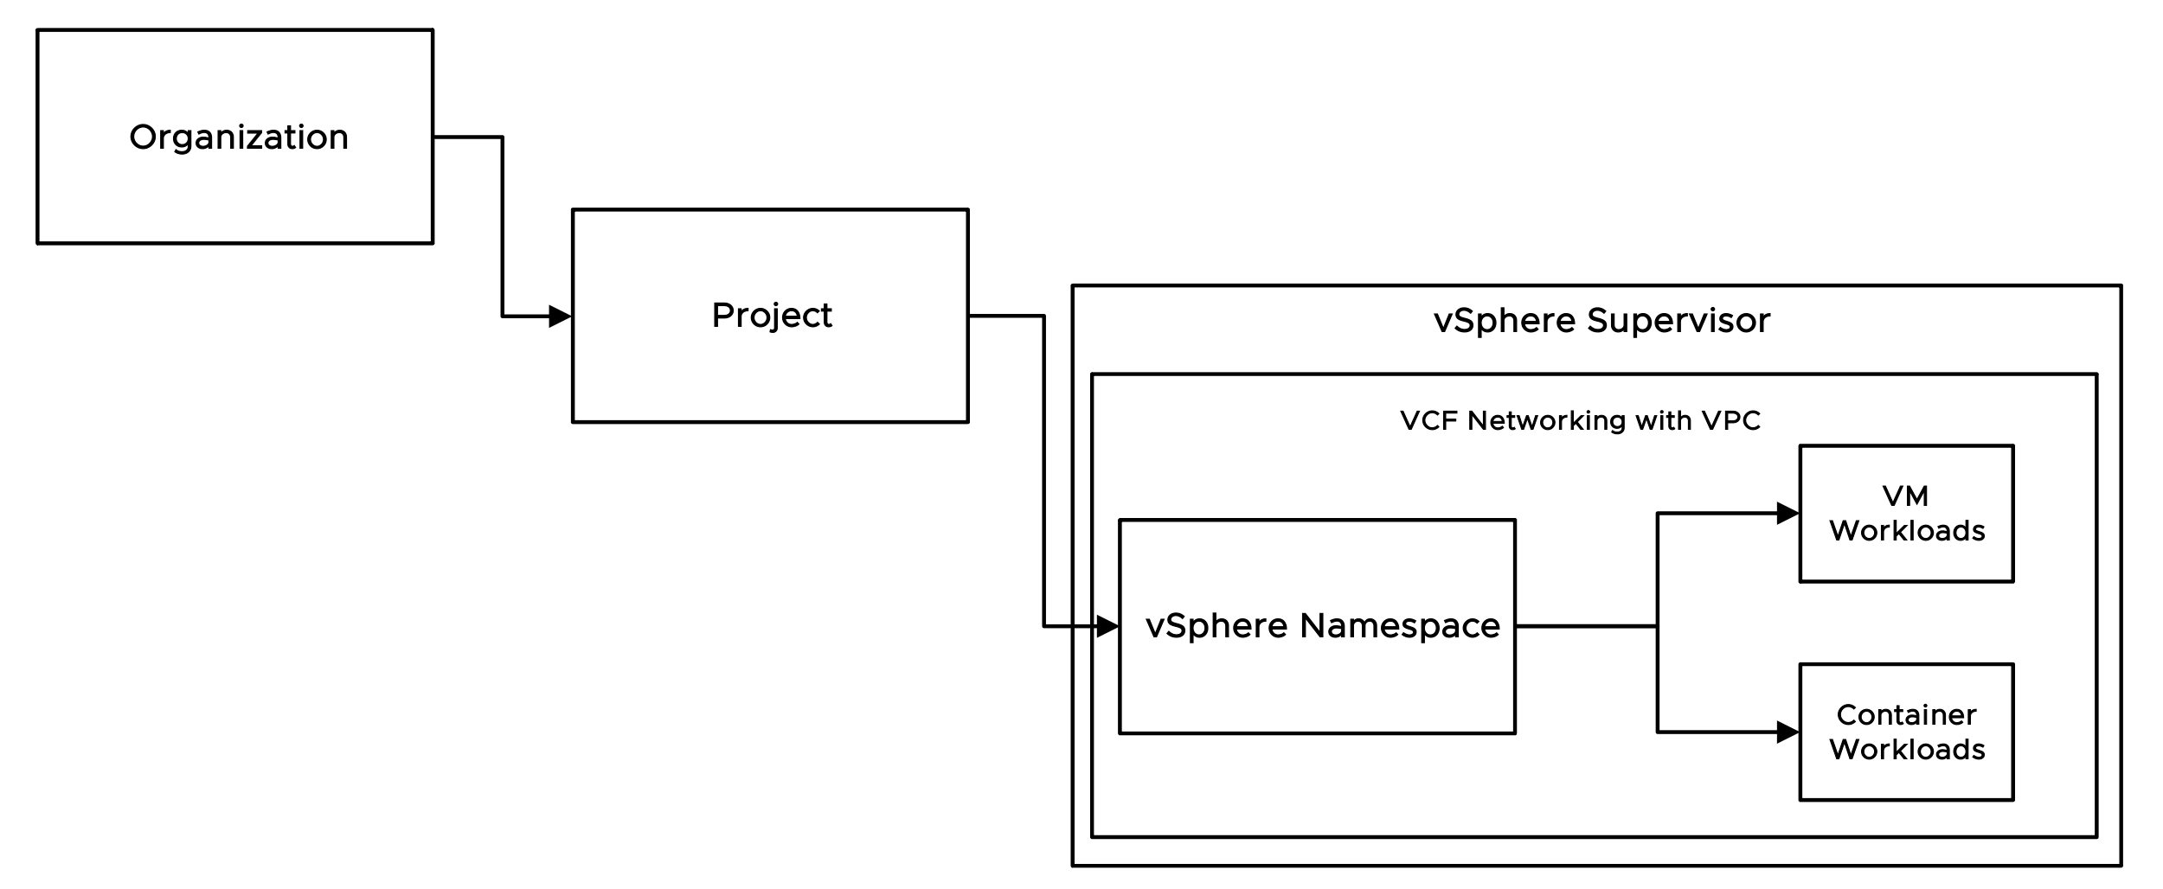
VCFA Object Flow (SVG Image)
Organization Construct Hierarchy
Notes:
Talk Track:
This is a high-level view of the constructs that comprise an Organization
Organizations – A top-level entity used to group and manage resources, users, policies, IaaS services, and catalog entities, while maintaining a secure boundary from other organizations
Projects – Connect users with the resources they are entitled to and the limits to which they are subject
Supervisor Clusters - Built on VKS using VCF Networking with Virtual Private Clouds (VPCs)
VCF Networking with VPC - Provides an isolated domain of networking resources that can be associated with one or more isolated domains of compute resources (vSphere namespace)
vSphere Namespaces - Define resource limits for CPU, memory, and storage for workloads such as VMs, Kubernetes clusters, and others
Workloads - Traditional VMs and container-based deployments within same infrastructure & managed with the same tools

Slide 28
Org Hierarchy with VPC v2
VCF Automation
Organization 01
Organization 01
Project 01
Project N
Project 01
Project N
VCF Networking with VPC
VCF Networking with VPC
VCF Networking with VPC
VCF Networking with VPC
VCF Networking with VPC
VCF Networking with VPC
VCF Networking with VPC
VCF Networking with VPC
vSphere Namespace 01
vSphere Namespace N
vSphere Namespace 01
vSphere Namespace N
vSphere Namespace 01
vSphere Namespace N
vSphere Namespace 01
vSphere Namespace N
Workload 1
Workload 1
Workload 1
Workload 1
Workload 1
Workload 1
Workload 1
Workload 1
Workload 2
Workload 2
Workload 2
Workload 2
Workload 2
Workload 2
Workload 2
Workload 2
Workload N
Workload N
Workload N
Workload N
Workload N
Workload N
Workload N
Workload N

Slide 29
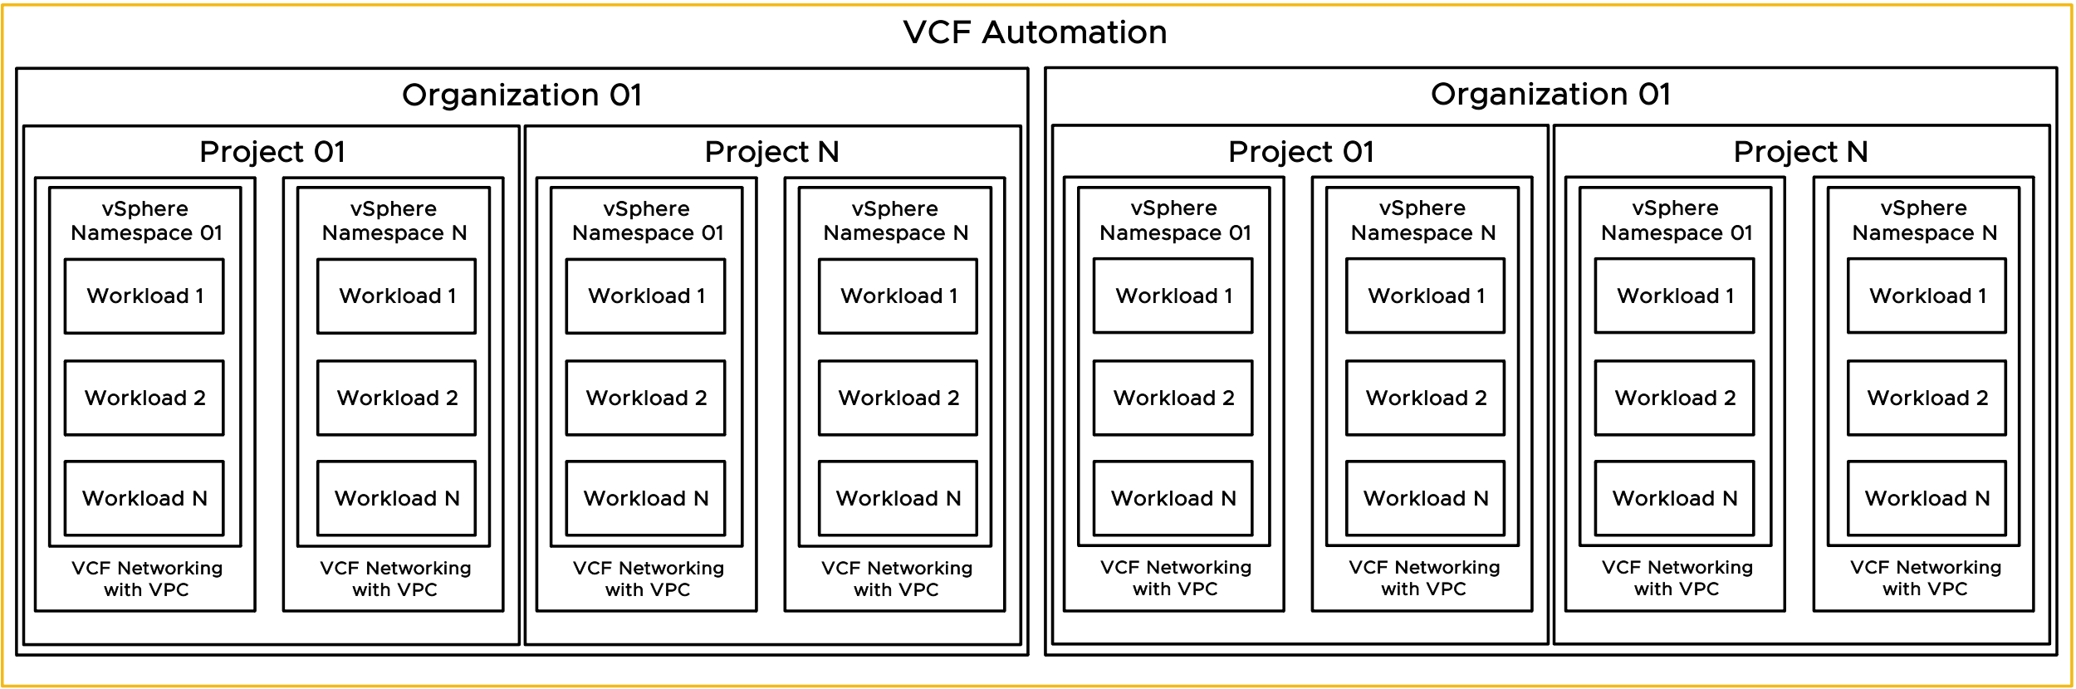
Org Hierarchy with VPC (SVG Image)

Slide 30
Provider Consumption Org v1
Flow Chart
VCF Automation
Provider / Enterprise Admin
Provider Management Functions
Provider Consumption Organization (PCO)
Visibility to allow for publishing of catalog items from PCO to Organizations
Organization 1
Organization 2
Organization N

Slide 31
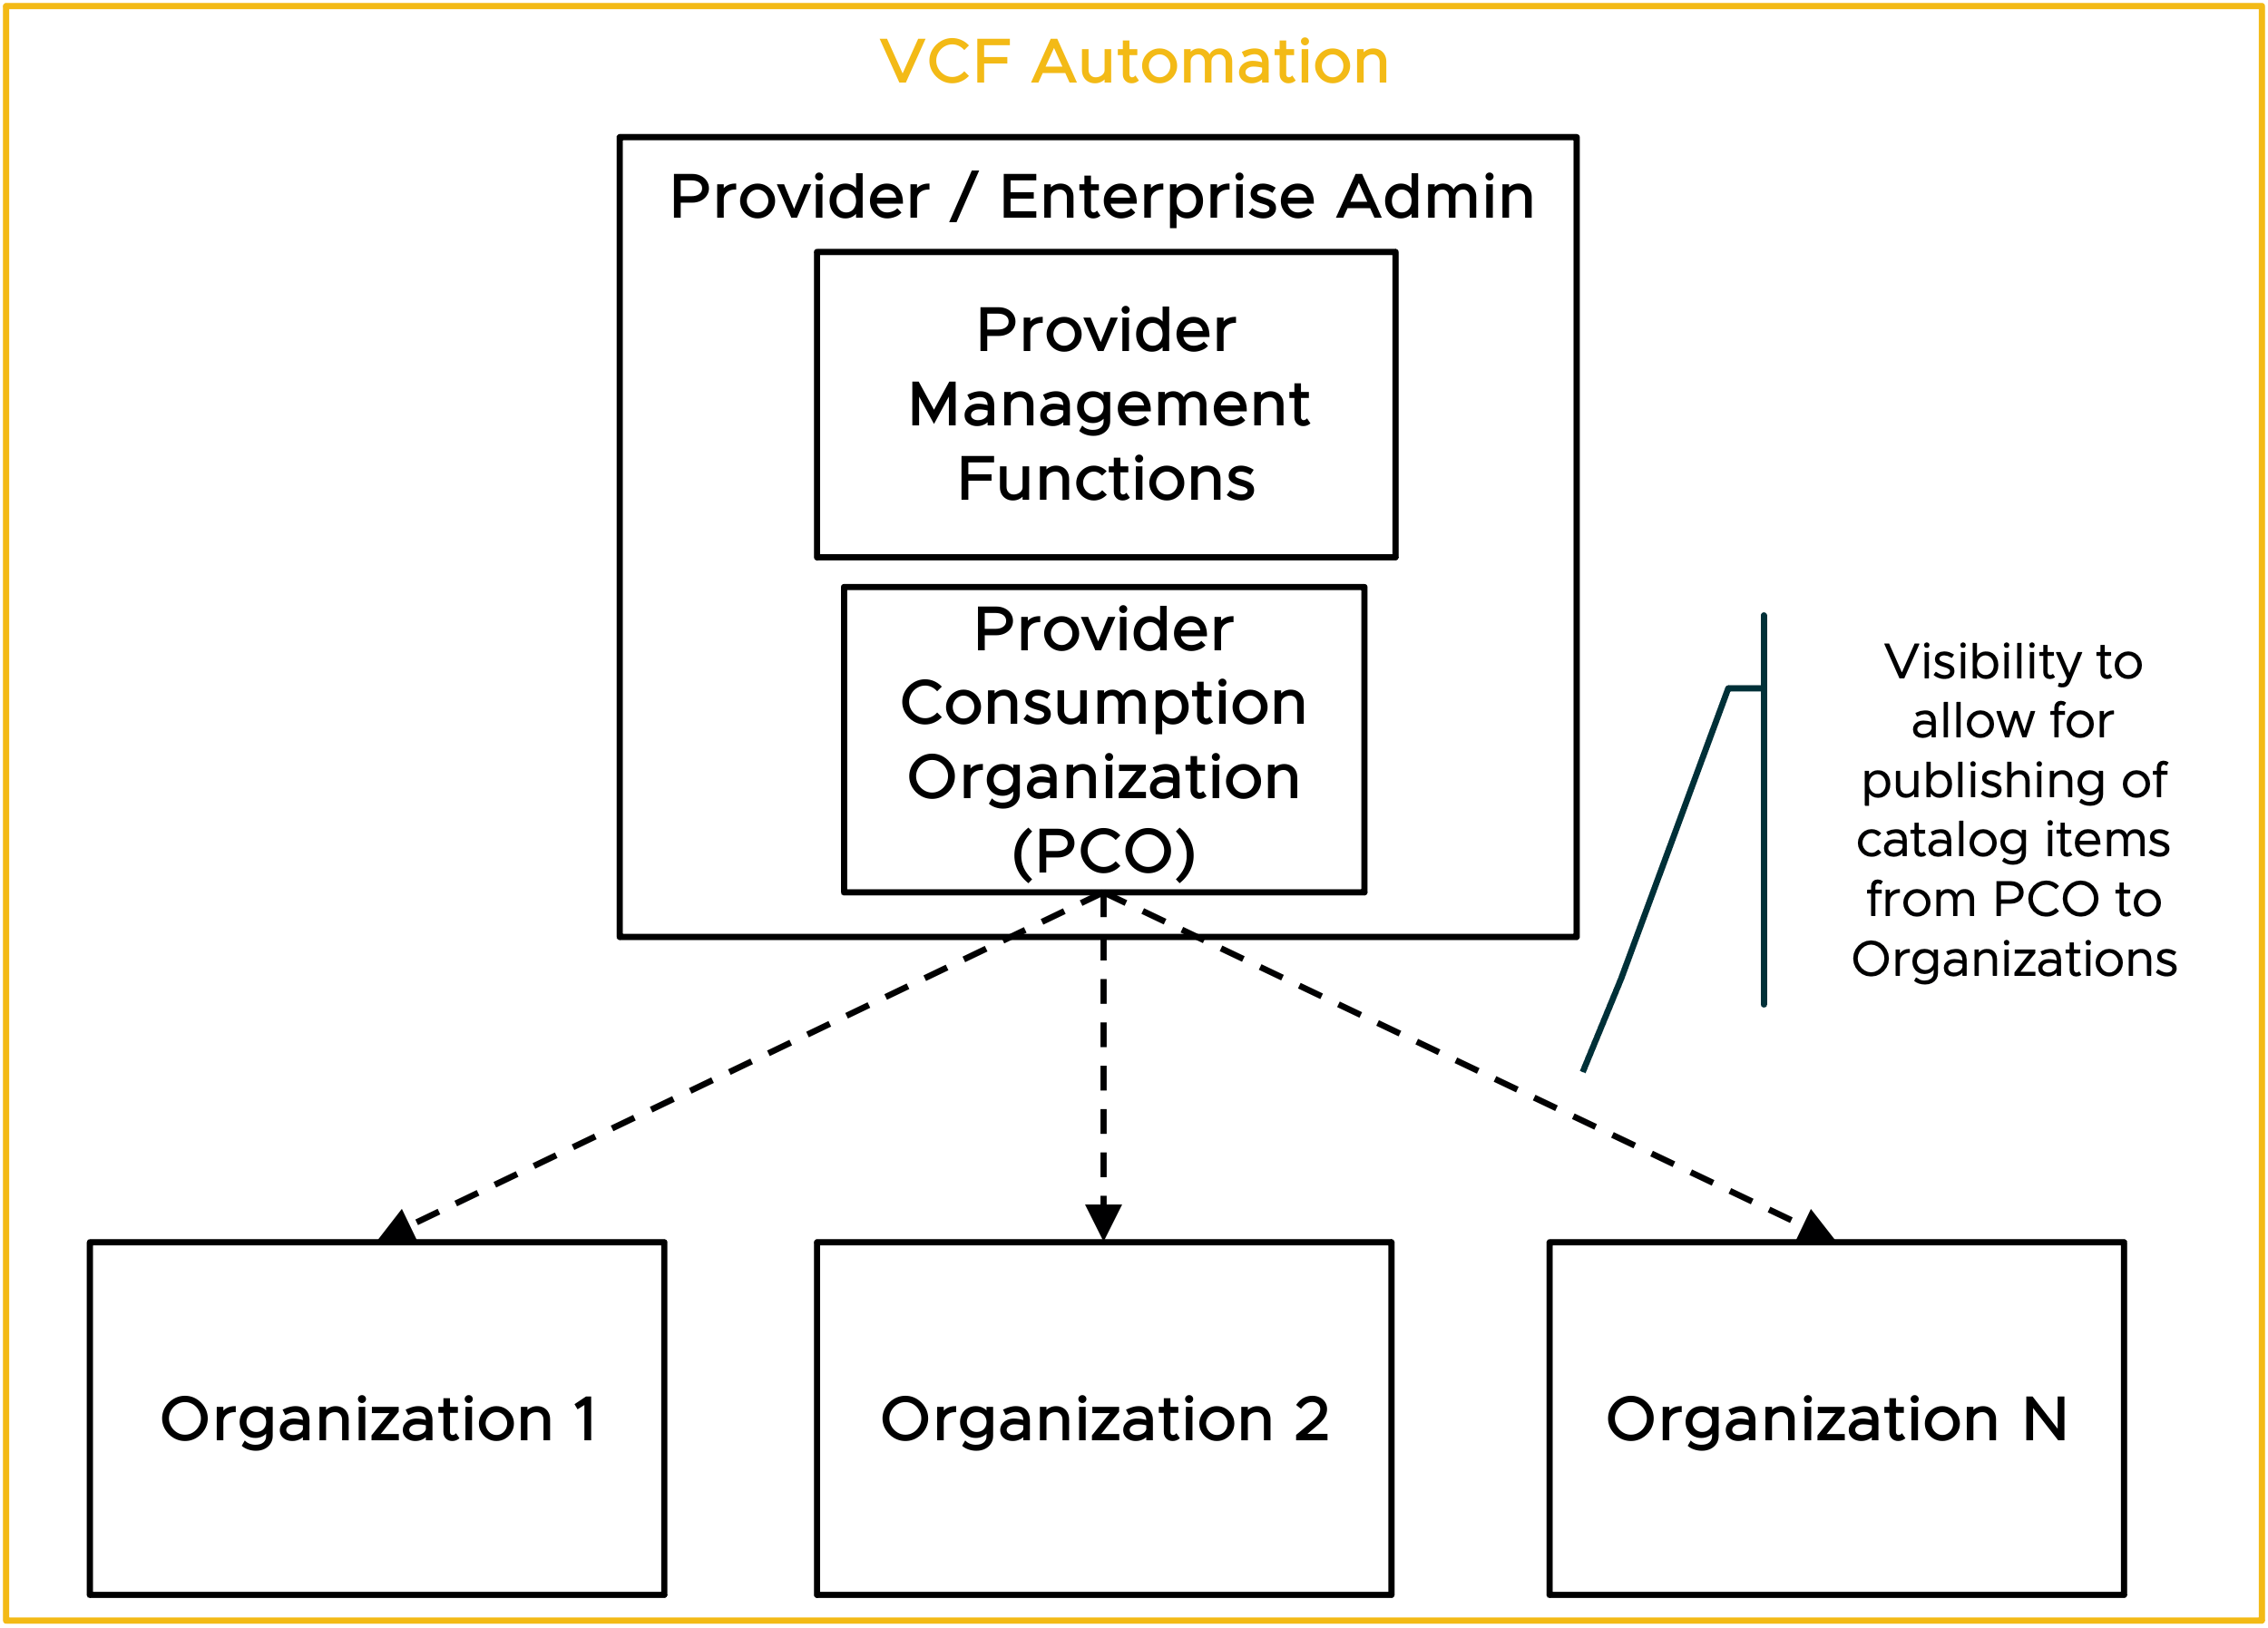
Provider Consumption Org (SVG Image)
Flow Chart

Slide 32
Example – Supervisor to Organization Relationship v1
Shared Infrastructure
Organization BigCo
Organization SmallCo
Tenant Level
Project - Apple
Project - Pear
Project - Corp
vSphere Namespace: Crisp
vSphere Namespace: Bartlett
BigCo
Org
Admins
vSphere Namespace: Finance
SmallCo
Org
Admins
vSphere Namespace: Mac
vSphere Namespace: Bosc
vSphere Namespace: Plant
zone1
zone2
zone3
zone4
zone5
zone6
zone1
zone2
zone3
Provider Level
vSphere
Cluster
vSphere
Cluster
vSphere
Cluster
vSphere
Cluster
vSphere
Cluster
vSphere
Cluster
vSphere
Cluster
vSphere
Cluster
vSphere
Cluster
Region West
vSphere Supervisor 1
Region East
Provider Admins
vSphere Supervisor 2
vSphere Supervisor 1
vCenter West 1
vCenter West 2
vCenter East 1
NSX Local Manager West
NSX Local Manager East
Notes:
Talk Track:
Technical view of showing further detail on how multiple organizations/tenants with multiple projects can be assigned on certain resources within the vSphere Supervisor infrastructure.
Specifically, this view shows
2 Tenants across 2 Regions
Regions
Region 1 includes two separate vCenters sharing one NSX Manager deployment
Region 2 single vCenter/NSX Pair
Tenant #1 – BigCo
2 Projects
2 vSphere Namespaces per Project
Region Quotas
One Region Quota assigning resources to Region West - vSphere Supervisor 1
One Region Quota assigning resources to Region East - vSphere Supervisor 1
Tenant #2 – Small Co
1 Project
2 vSphere Namespaces
One Region Quota assigning resources to Region West - vSphere Supervisor 2
One Region Quota assigning resources to Region East - vSphere Supervisor 1
Note: Each Organization requires a Region Quota that maps the Supervisor in the Region to the Organization. Each Region can only map 1 Supervisor per region. This is why you see BigCo mapped to Region West Supervisor 1 and SmallCo mapped to Region West Supervisor 2.

Slide 33
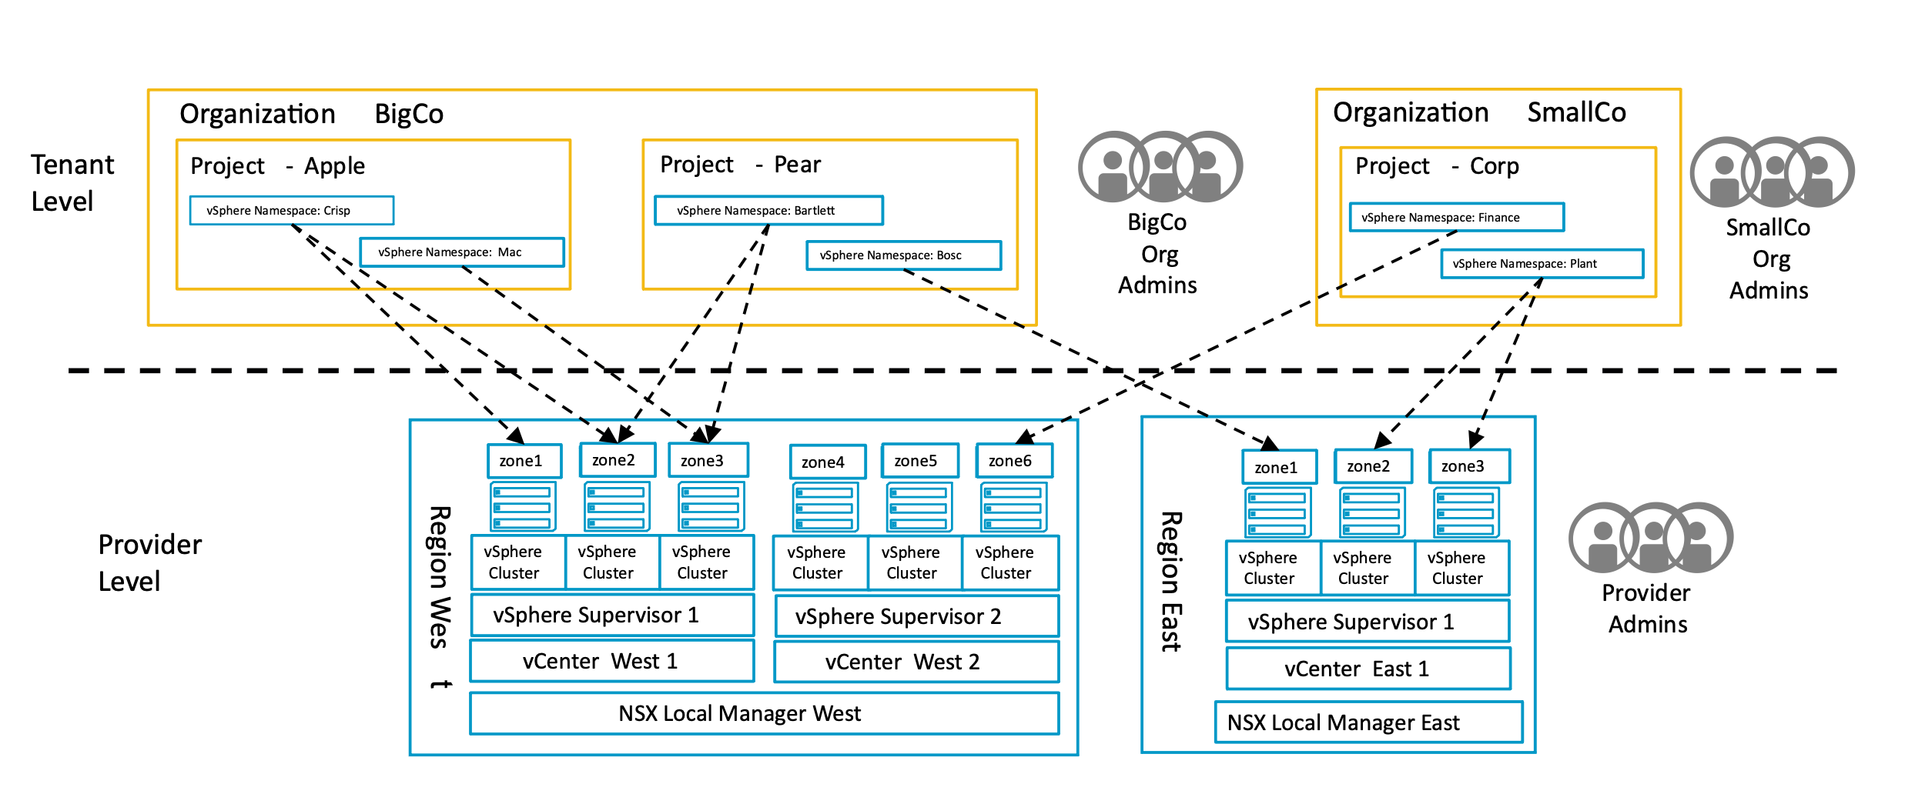
Example – Supervisor to Organization Relationship (SVG Image)

Slide 34

VCFA Org Model v1
VCF Automation Organization for All Apps
Project
Project Admins
Zones
vSphere Namespace
VM Classes
Storage Classes
Org
Admins
Content Libraries
VPC
Connectivity Profile
Private VPC CIDR
Private TGW IP Blocks
w.x.y.z
a.b.c.d
Org IAM
Org IdP
VCF Automation Provider Level
zone1
zone2
zone3
Provider Gateway
Regional Quota
vSphere
Cluster
vSphere
Cluster
vSphere
Cluster
Shared Content Libraries
T0 Gateway
Region
Default Namespaces
External IP Blocks
Provider Admins
vSphere Supervisor
StorageClasses
e.f.g.h
vCenter
VirtualMachineClasses
NSX Local Manager
Provider IAM
Provider IdP
Notes:
Talk Track:
Technical view of showing further detail on how multiple organizations/tenants with multiple projects can be assigned on certain resources within the vSphere Supervisor infrastructure.
Specifically, this view shows
2 Tenants across 2 Regions
Regions
Region 1 includes two separate vCenters sharing one NSX Manager deployment
Region 2 single vCenter/NSX Pair
Tenant #1 – BigCo
2 Projects
2 vSphere Namespaces per Project
Region Quotas
One Region Quota assigning resources to Region West - vSphere Supervisor 1
One Region Quota assigning resources to Region East - vSphere Supervisor 1
Tenant #2 – Small Co
1 Project
2 vSphere Namespaces
One Region Quota assigning resources to Region West - vSphere Supervisor 2
One Region Quota assigning resources to Region East - vSphere Supervisor 1
Note: Each Organization requires a Region Quota that maps the Supervisor in the Region to the Organization. Each Region can only map 1 Supervisor per region. This is why you see BigCo mapped to Region West Supervisor 1 and SmallCo mapped to Region West Supervisor 2.

Slide 35
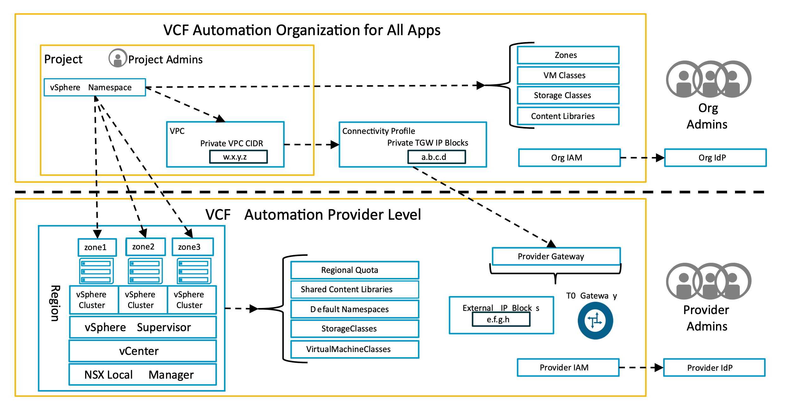
VCFA Org Model (SVG)

Slide 36
Workload Domain Models

Slide 37
Workload Domain Models v1
VCF Instance
Management Domain
Workload Domain
vCenter
vCenter
NSX Manager
NSX Manager
SDDC Manager

Slide 38
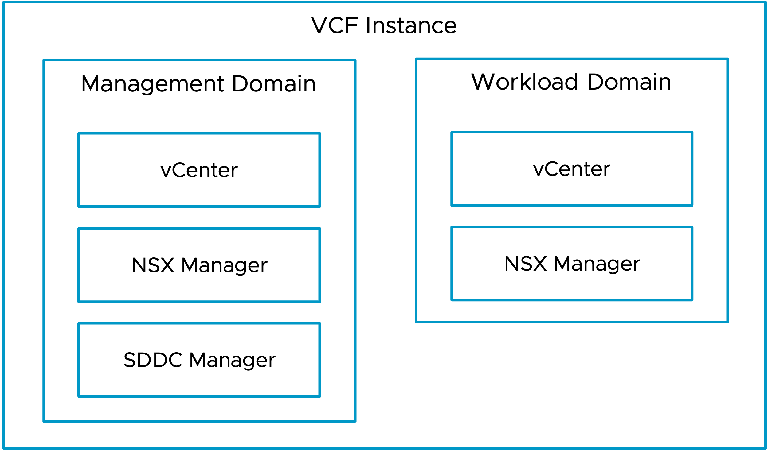
Workload Domain Models v1 (SVG Image)

Slide 39
Distributed Switch Models

Slide 40
Distributed Switch Models v1
Single
Distributed Switch
Storage Separation
Distributed Switch
Workload Separation
Distributed Switch
Storage and Workload Separation
Distributed Switch
ESX Host
ESX Host
ESX Host
ESX Host
VM Mgmt
vDS Uplinks
VM Mgmt
vDS Uplinks
VM Mgmt
vDS Uplinks
VM Mgmt
vDS Uplinks
ESX Mgmt
ESX Mgmt
ESX Mgmt
ESX Mgmt
vMotion
vMotion
vMotion
vMotion
Storage
Virtual Networking
Storage
vDS Uplinks
Storage
Virtual Networking
vDS Uplinks
vDS Uplinks
Storage
Virtual Networking
vDS Uplinks
Virtual Networking

Slide 41
NSX Edge Cluster Models
Single Availability Zones

Slide 42
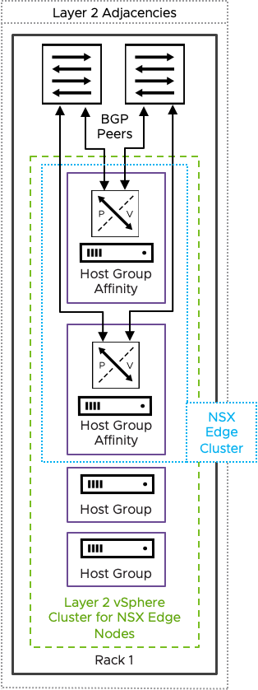
Host Fault Tolerant NSX Edge Cluster

Slide 43
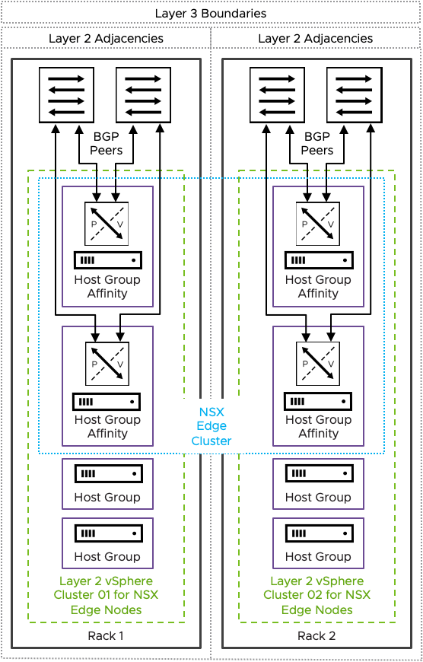
Rack Fault Tolerant Design using two or more vertical Layer 2 vsphere clusters in separate racks

Slide 44
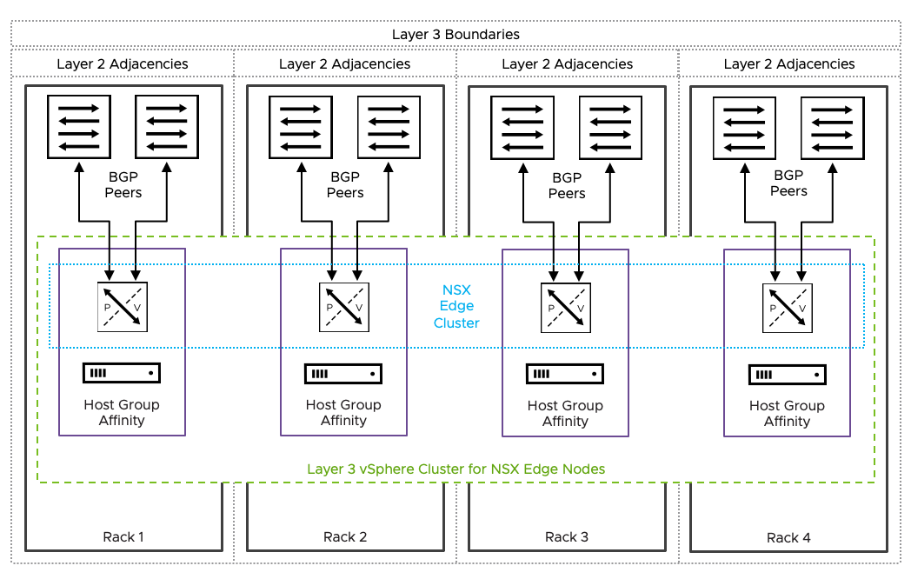
Rack Fault Tolerant Design using a single Layer 3 vsphere Cluster deployed across multiple racks

Slide 45
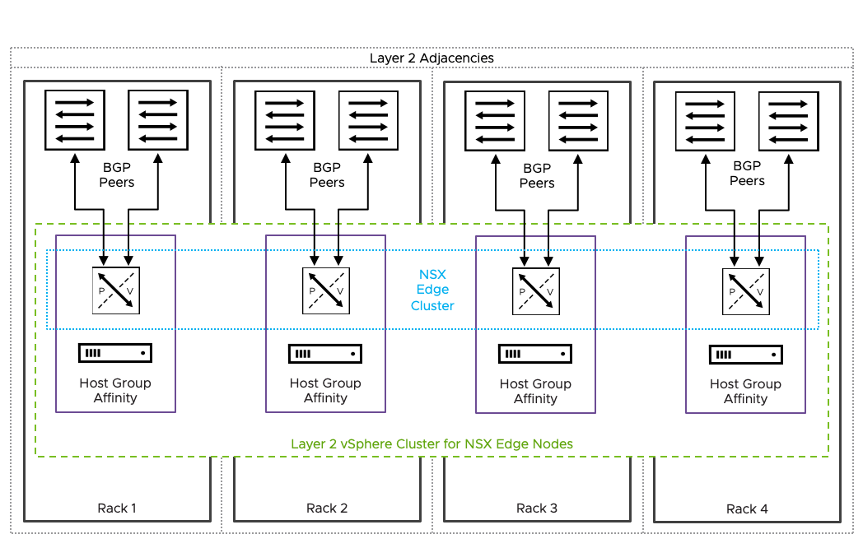
Rack Fault Tolerant Design using a single Layer 2 vsphere Cluster deployed across multiple racks

Slide 46
NSX Edge Cluster Models
Dual Availability Zones

Slide 47
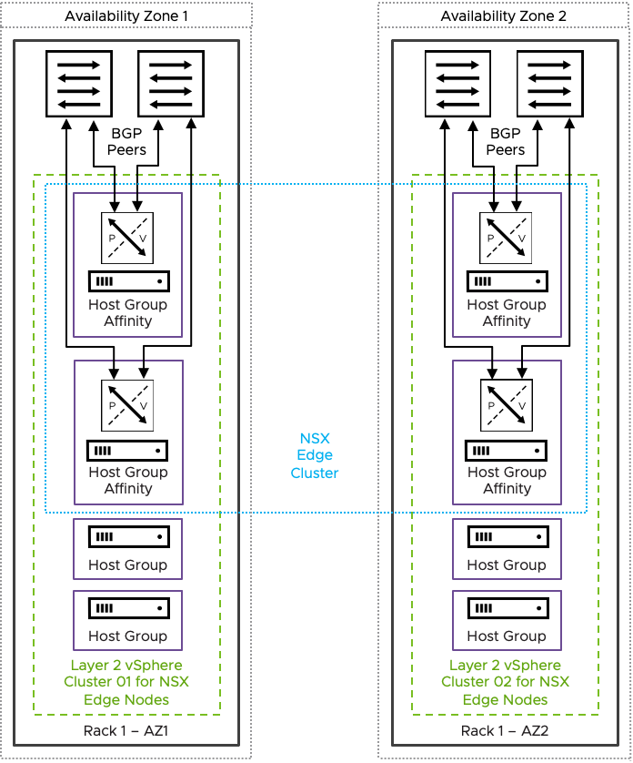
Dual Availability Zone Design based on NSX Edge Node HA - Dedicated vSphere cluster

Slide 48
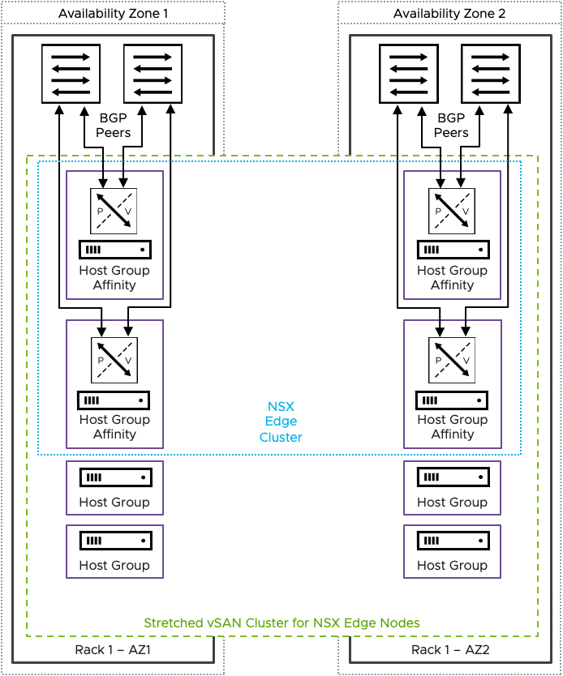
Dual Availability Zone Design based on NSX Edge Node HA - stretched vSAN cluster

Slide 49
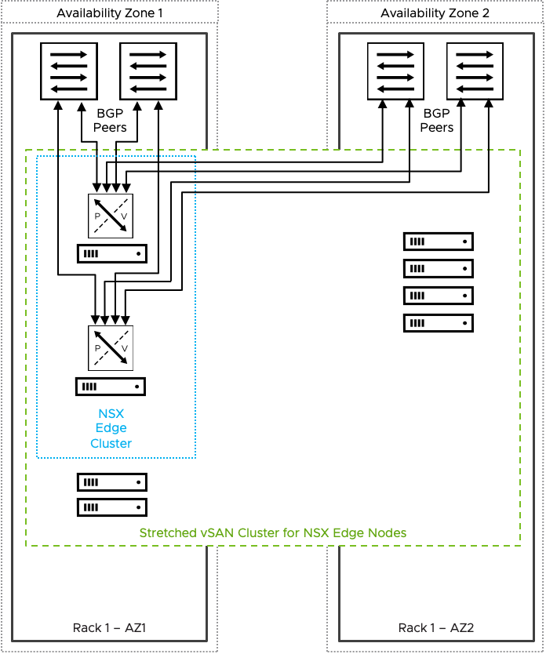
Dual Availability Zone Design based on vSphere HA Recovery

Slide 50
Supervisor Models

Slide 51
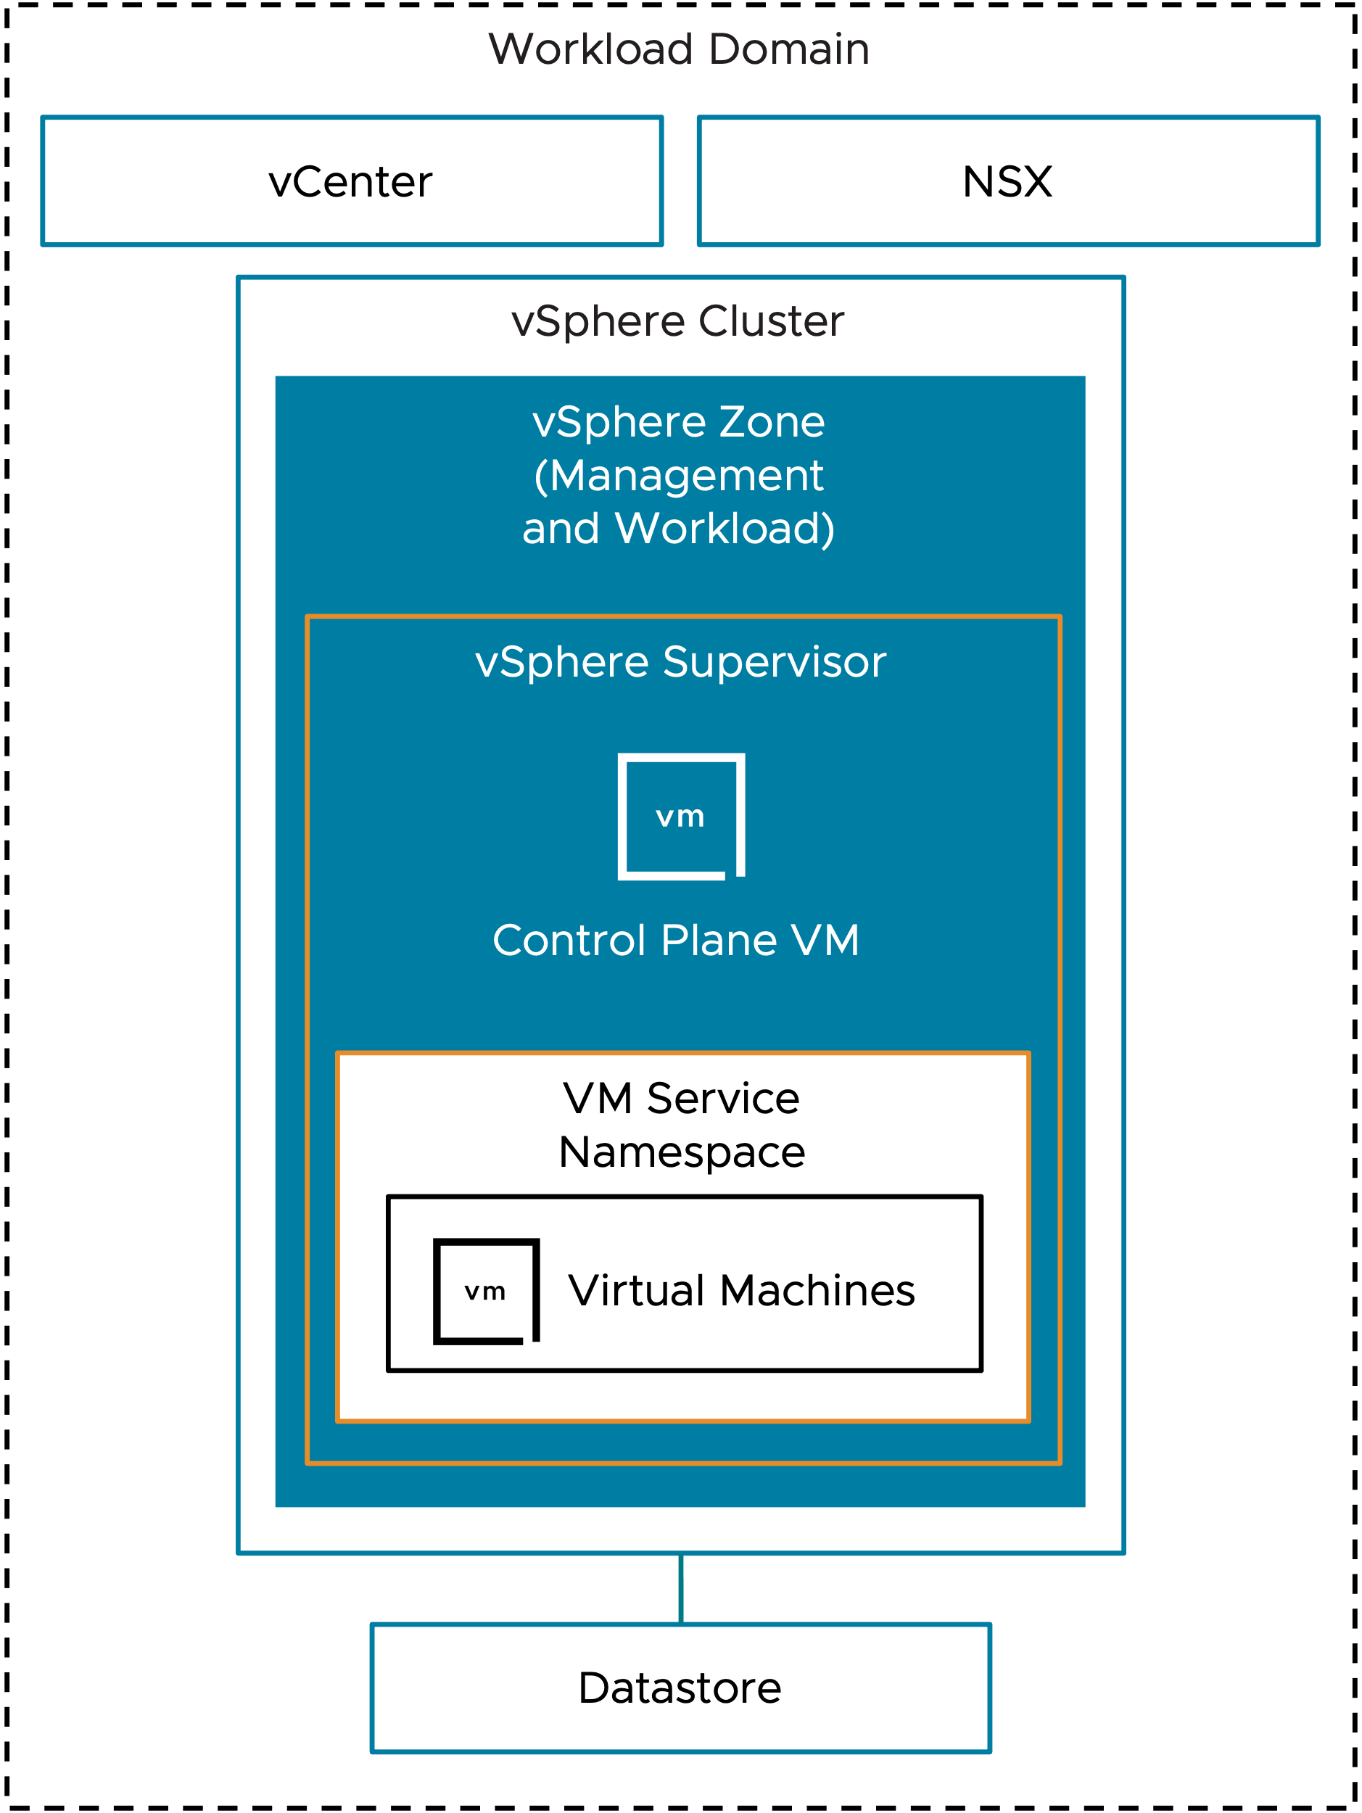
Simplified Supervisor
Workload Domain
vCenter
NSX
vSphere Cluster
vSphere Zone (Management and Workload)
vSphere Supervisor
Control Plane VM
VM Service
Namespace
Virtual Machines
Datastore

Slide 52
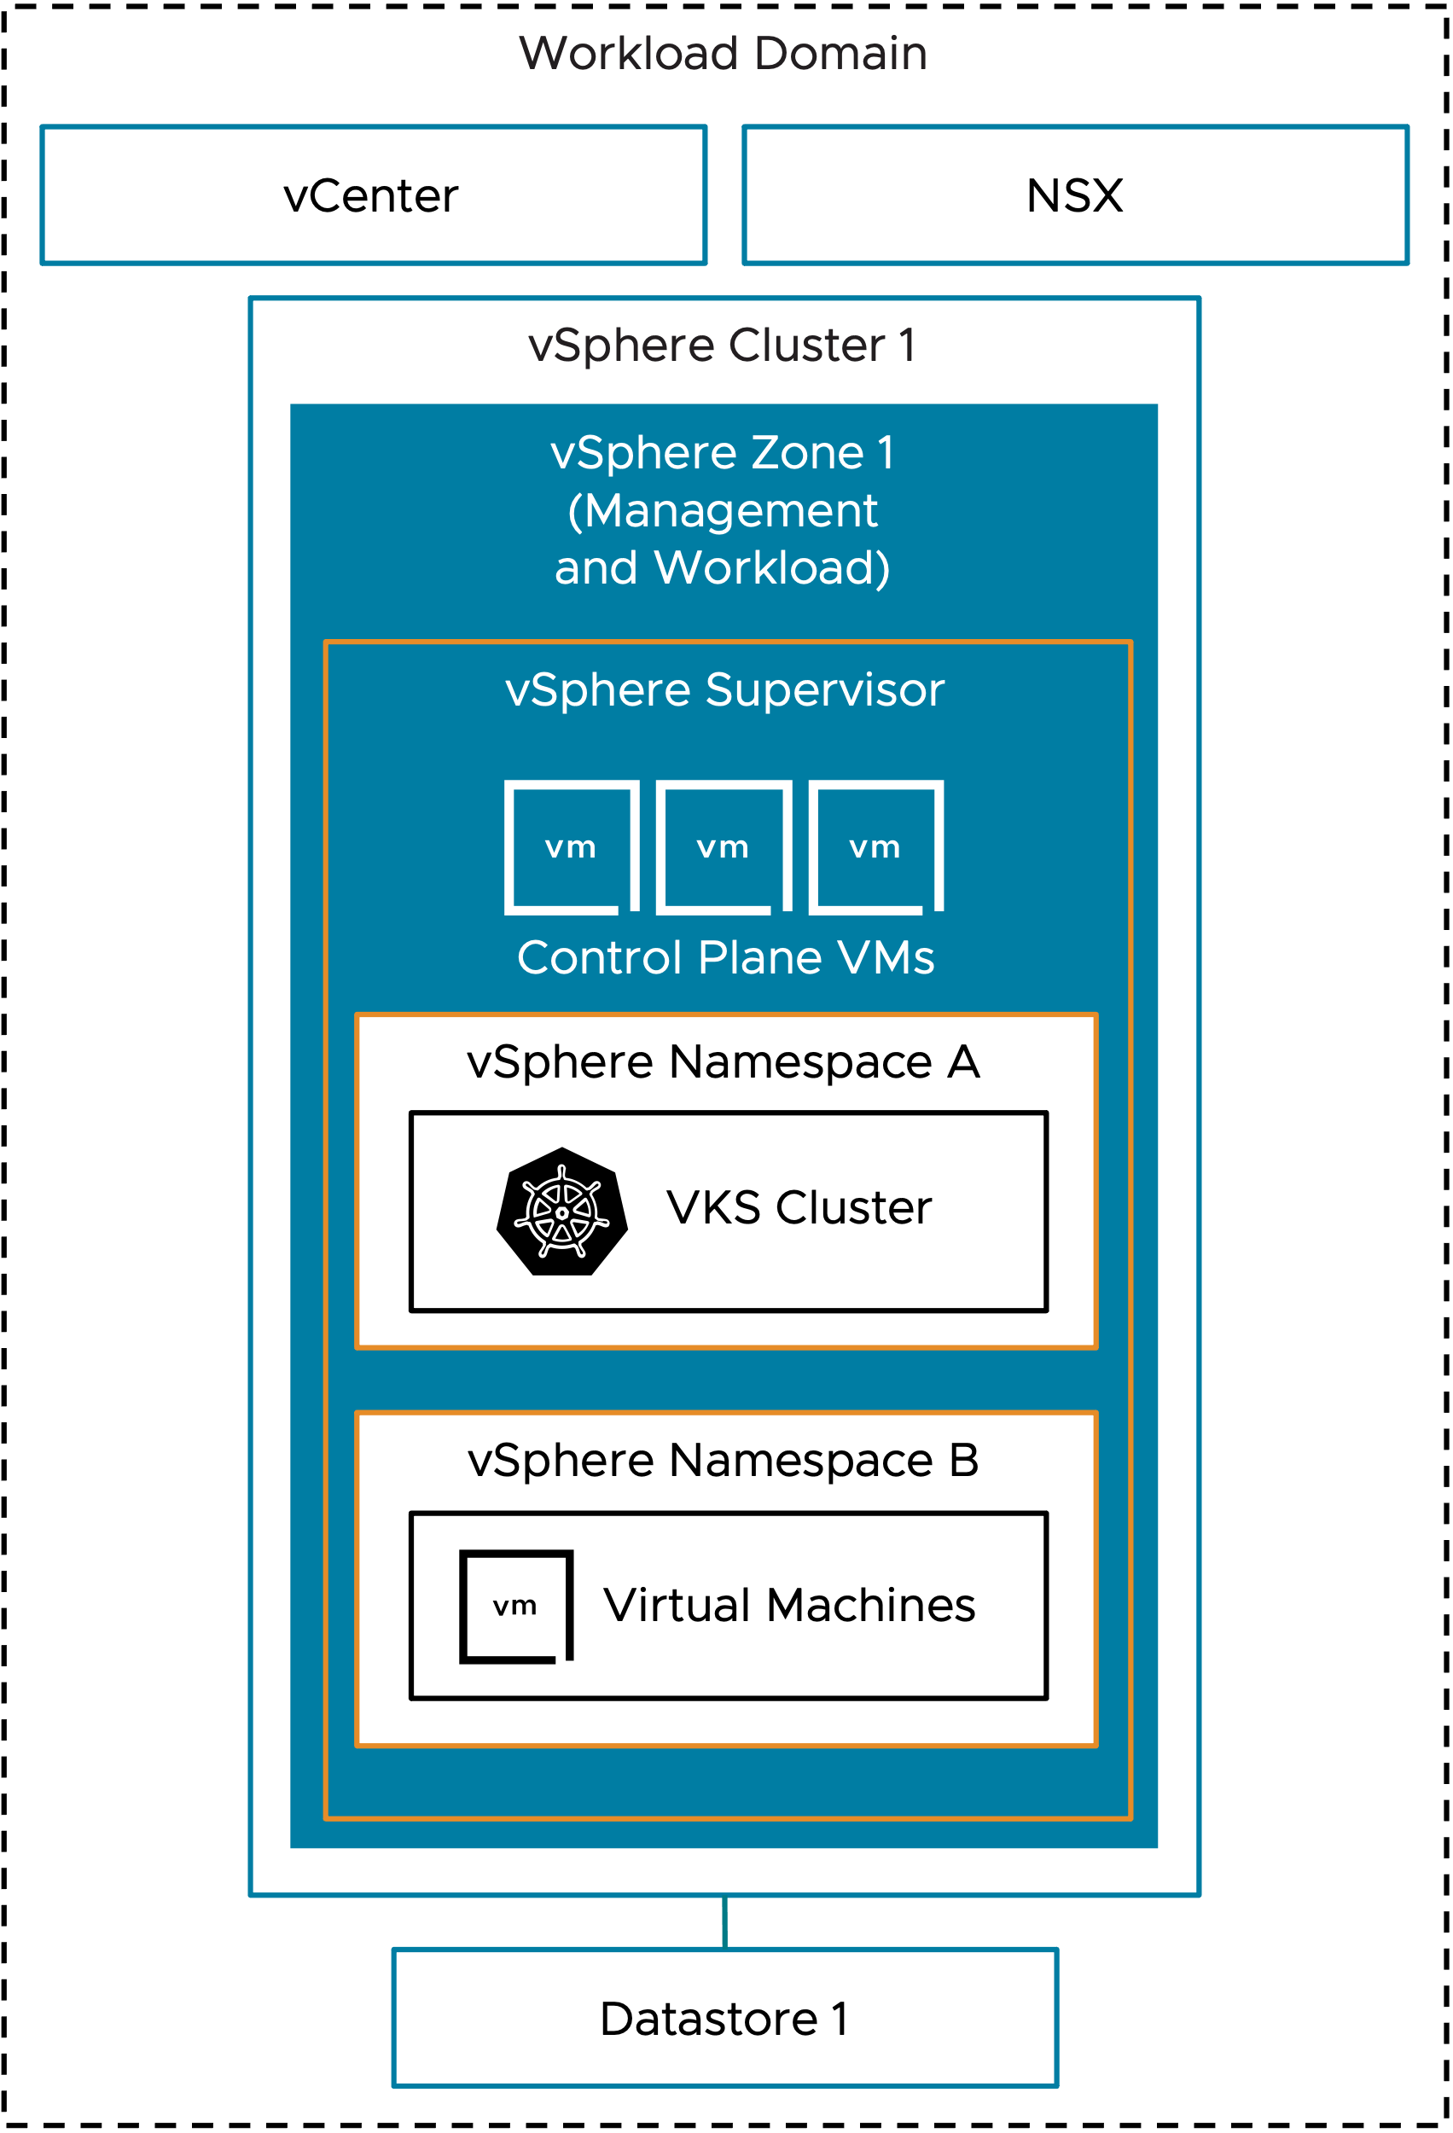
Single Management Zone with Combined Workload Zones Model
Workload Domain
vCenter
NSX
vSphere Cluster 1
vSphere Zone 1 (Management and Workload)
vSphere Supervisor
Control Plane VMs
vSphere Namespace A
VKS Cluster
vSphere Namespace B
Virtual Machines
Datastore 1

Slide 53
Single Management Zone with Isolated Workload Zones Model
Workload Domain
vCenter
NSX
vSphere Cluster 1
vSphere Cluster 2
vSphere Cluster 3
vSphere Cluster 4
vSphere Zone 1 (Management)
vSphere Zone 2 (Workload)
vSphere Zone 3 (Workload)
vSphere Zone 4 (Workload)
Supervisor
vSphere Supervisor
vSphere Namespace A
Control Plane VMs
VKS Clusters
vSphere Namespace B
vSphere Namespace C
VKS Clusters
Virtual Machines
Datastore 1
Datastore 2
Datastore 3
Datastore 4

Slide 54
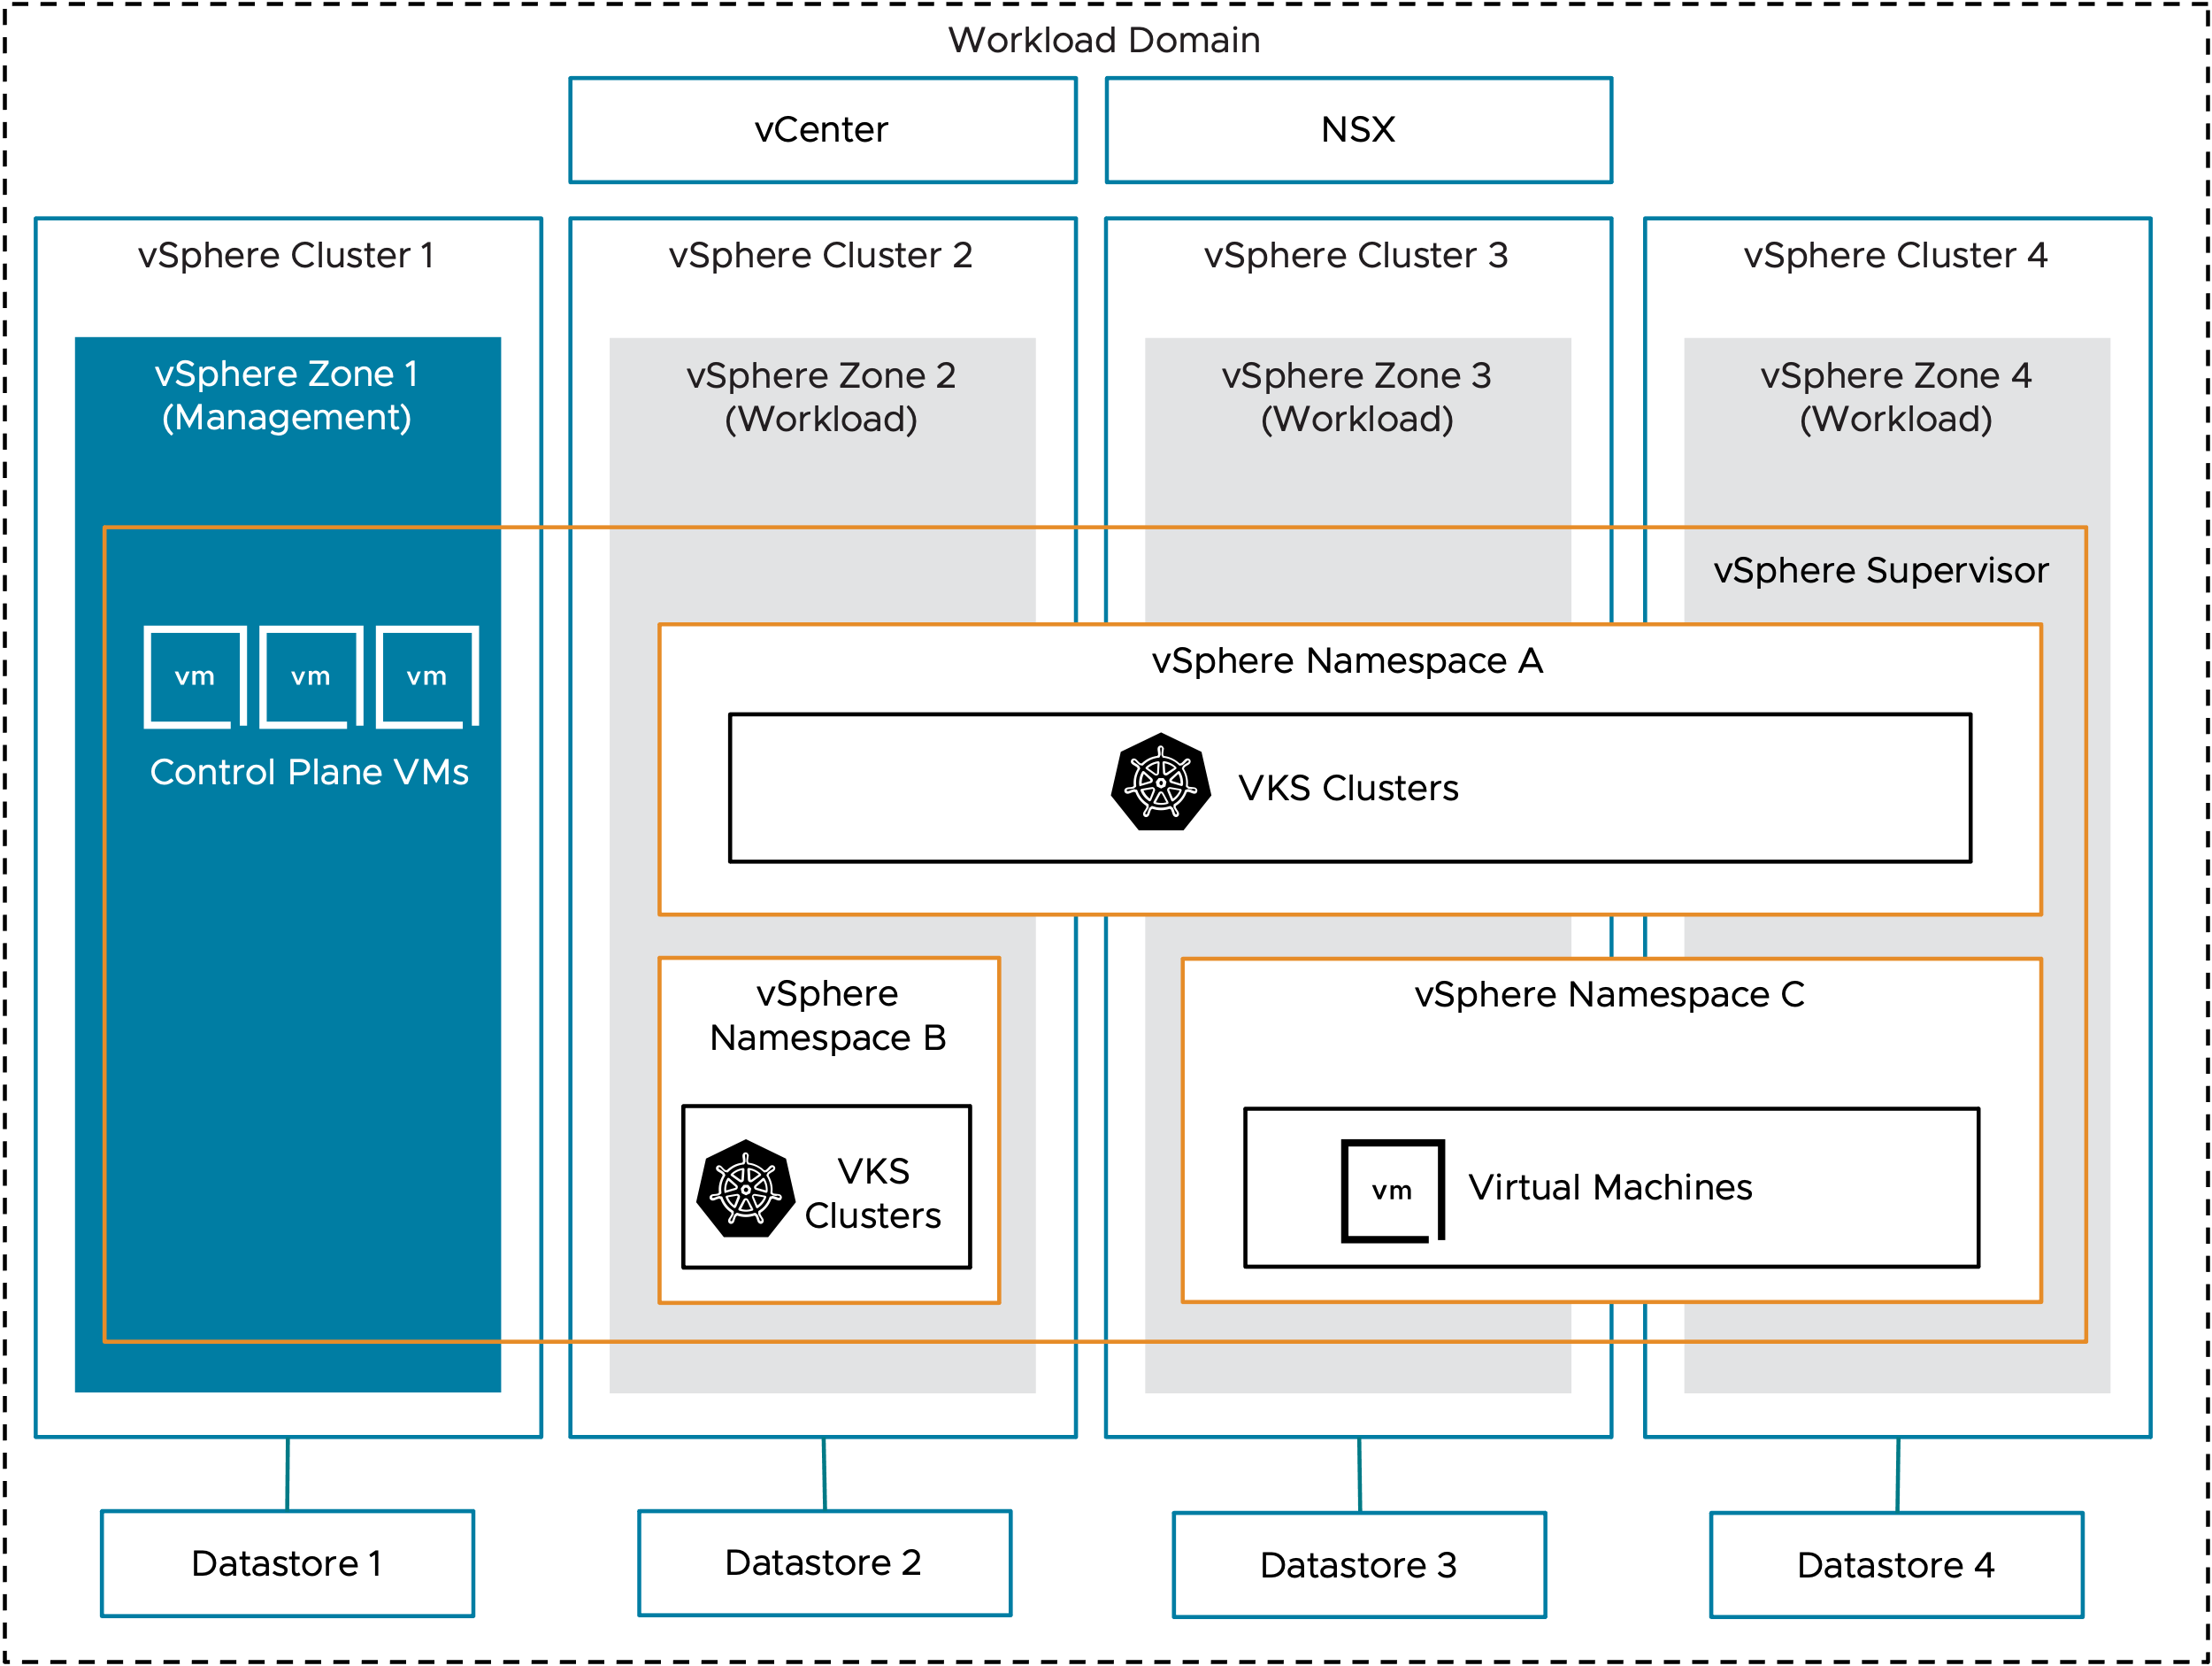
Single Management Zone with Isolated Workload Zones Model (SVG)

Slide 55
Three Management Zones with Combined Workload Zones Model
Workload Domain
vCenter
NSX
vSphere Cluster 1
vSphere Cluster 2
vSphere Cluster 3
vSphere Zone 1 (Management and Workload)
vSphere Zone 2 (Management and Workload)
vSphere Zone 3 (Management and Workload)
vSphere Supervisor
Control Plane VM 1
Control Plane VM 2
Control Plane VM 3
vSphere Namespace A
VKS Clusters
vSphere Namespace B
vSphere Namespace C
vSphere Pods
Virtual Machines
Datastore 1
Datastore 2
Datastore 3

Slide 56
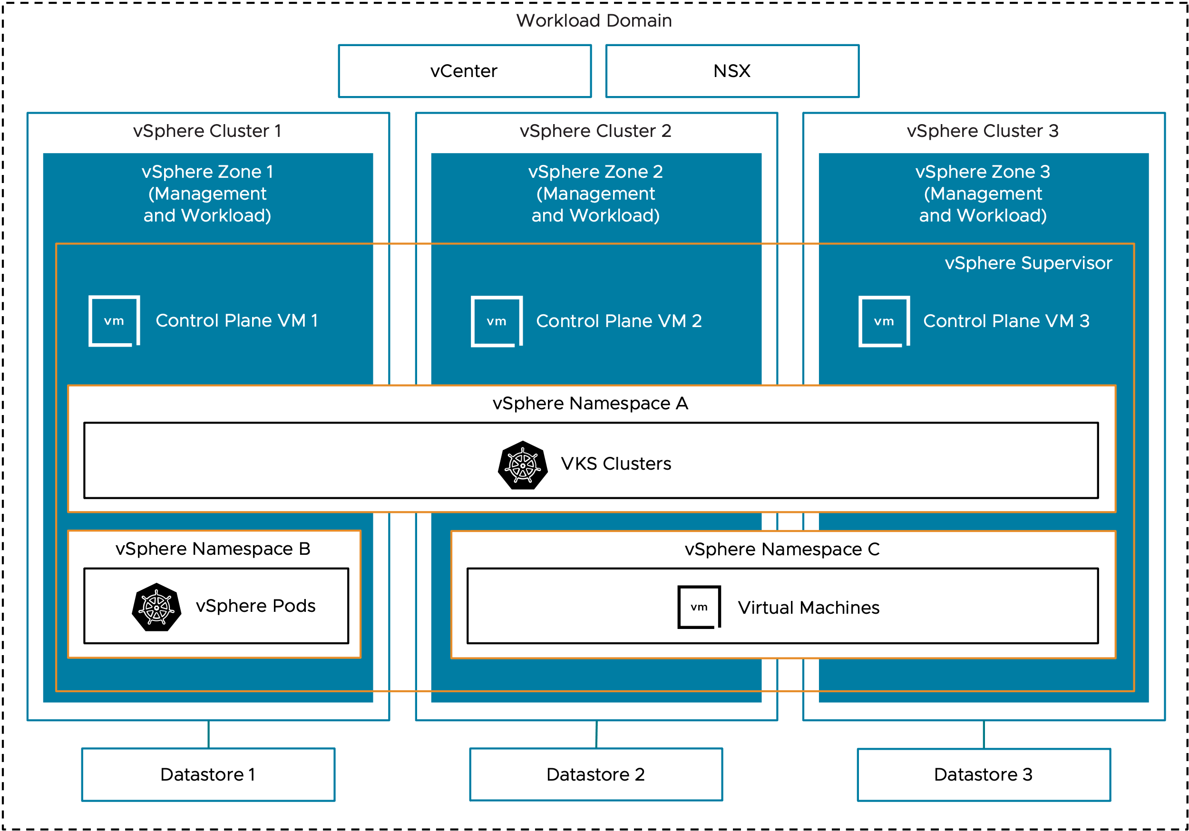
Three Management Zones with Combined Workload Zones Model (SVG)

Slide 57
Three Management Zones with Isolated Workload Zones Model
Workload Domain
vCenter
NSX
vSphere Cluster 1
vSphere Cluster 2
vSphere Cluster 3
vSphere Cluster 4
vSphere Cluster 5
vSphere Cluster 6
vSphere Zone 1 (Management)
vSphere Zone 2 (Management)
vSphere Zone 3 (Management)
vSphere Zone 4 (Workload)
vSphere Zone 5 (Workload)
vSphere Zone 6 (Workload)
vSphere Supervisor
vSphere Namespace A
VKS Cluster
Control Plane VM1
Control Plane VM2
Control Plane VM3
vSphere Namespace B
vSphere Namespace C
vSphere
Pods
Virtual Machines
Datastore 1
Datastore 2
Datastore 3
Datastore 4
Datastore 5
Datastore 6

Slide 58
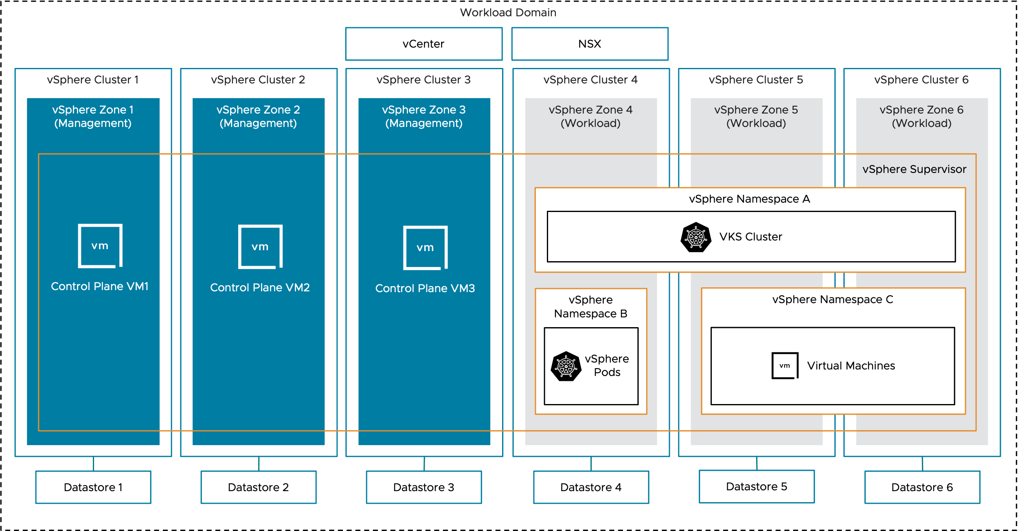
Three Management Zones with Isolated Workload Zones Model (SVG)

Slide 59
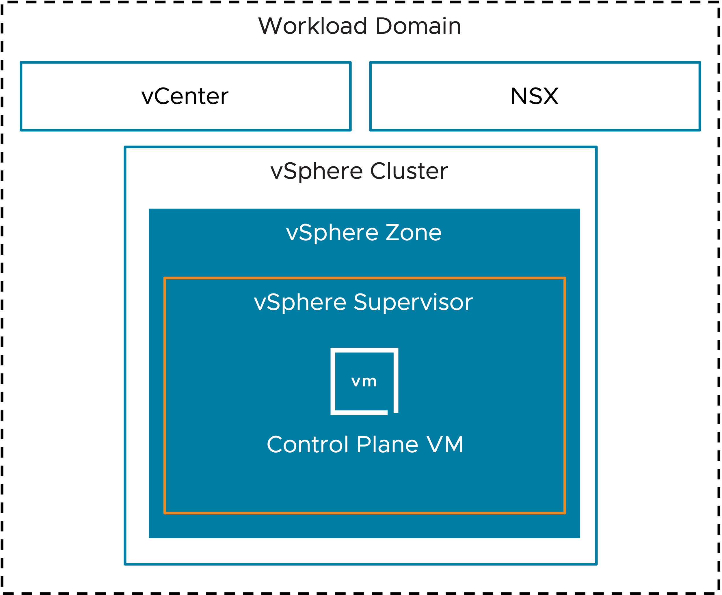
Simple Control Plane Model
Workload Domain
vCenter
NSX
vSphere Cluster
vSphere Zone
vSphere Supervisor
Control Plane VM

Slide 60
High Availability Control Plane Model
Single Management Zone
Three Management Zones
Workload Domain
Workload Domain
vCenter
NSX
vCenter
NSX
vSphere Cluster
vSphere Cluster 1
vSphere Cluster 2
vSphere Cluster 3
vSphere Zone
vSphere Zone 1
vSphere Zone 2
vSphere Zone 3
vSphere Supervisor
vSphere Supervisor
Control Plane VMs
Control Plane VM 1
Control Plane VM 2
Control Plane VM 3

Slide 61
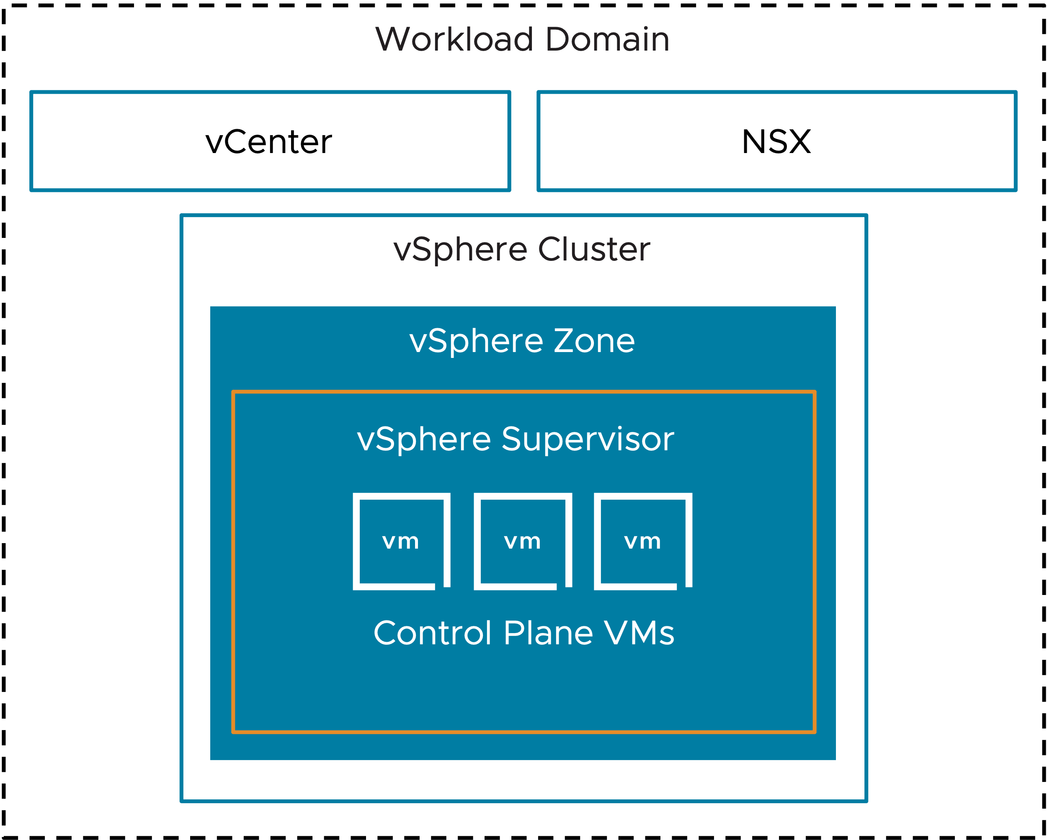
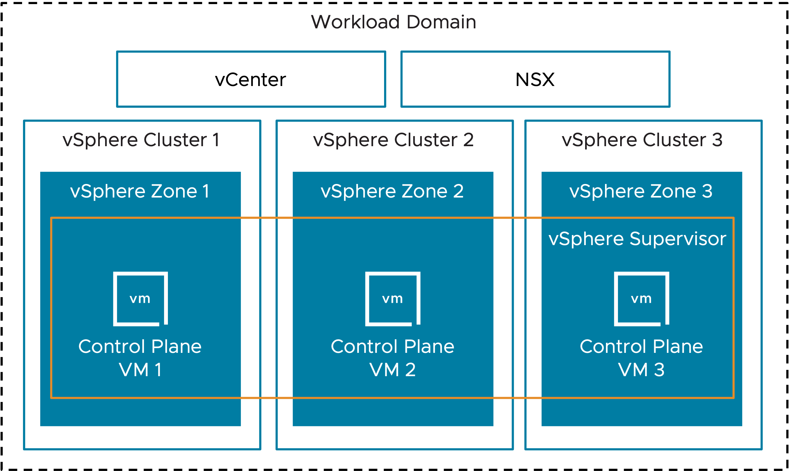
High Availability Control Plane Model (SVG)
Single Management Zone
Three Management Zones

Slide 62
vSAN Diagrams

Slide 63


Standard vSAN Cluster
VCF Instance
Workload Domain
Availability Zone
Rack
vSAN Cluster

Slide 64
Choices
Start choosing an architectural model for vSAN
Flash NVMe devices supported with vSAN ESA?
Yes
No
Use vSAN (ESA) Express Storage Architecture.
Use vSAN (OSA) Original Storage Architecture.
Single Tier Storage Architecture.
25Gb Network strongly recommended
Tiered Storage Architecture.
Mix of SAS, SATA or NVMe devices supported
End

Slide 65

2-Pnic shared network
vDS Uplinks
vDS01
VM Mgmt
ESX Mgmt
vMotion
vSAN Storage
Virtual Networking
ESX Host

Slide 66
4-Pnic storage separation network
vDS Uplinks
vDS Uplinks
vDS01
vDS02
VM Mgmt
ESX Mgmt
vMotion
Virtual Networking
vSAN Storage
ESX Host

Slide 67

Standard vSAN ESA Cluster
VCF Instance
Workload Domain
Availability Zone
Rack
Storage Pool
Storage Pool
Storage Pool
Storage Pool
vSAN HCI Cluster ( ESA )

Slide 68
Standard vSAN OSA Cluster
VCF Instance
Workload Domain
Availability Zone
Rack
Disk Groups
Disk Groups
Disk Groups
Disk Groups
vSAN HCI Cluster ( OSA )

Slide 69
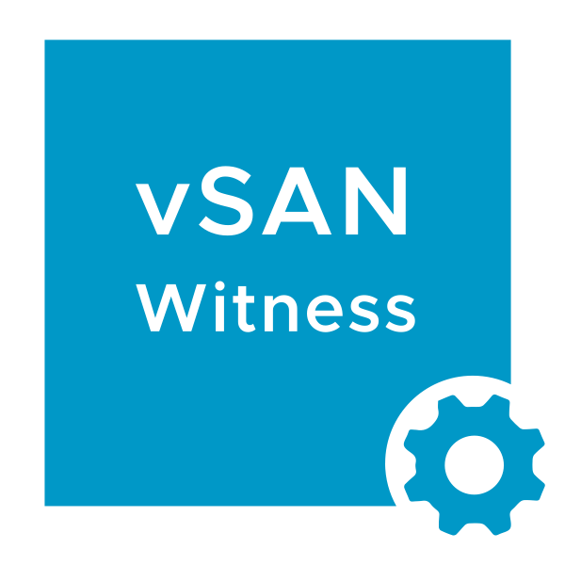
vSAN Stretched Cluster
VCF Instance
Workload Domain
Availability Zone 3
Availability Zone 1
Availability Zone 2
Rack
Rack
vSAN Stretched Cluster

Slide 70


vSAN Storage + Compute Clusters
VCF Instance
Workload Domain
Availability Zone
Rack
Rack
vSAN Compute Cluster
vSAN Storage Cluster
vSAN Compute Cluster
vSAN Compute Cluster

Slide 71
vSAN Compute Cluster
VCF Instance
Workload Domain
Availability Zone
Rack
vSAN Compute Cluster

Slide 72
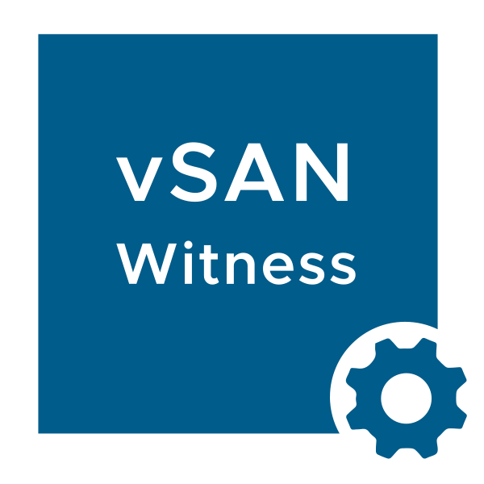
vSAN Stretched-Storage and compute
VCF Instance
Workload Domain
Availability Zone 3
Availability Zone 1
Availability Zone 2
Rack
Rack
Rack
Rack
vSAN Stretched Storage Cluster
vSAN Compute Cluster
vSAN Compute Cluster
Rack
Rack
vSAN Stretched Compute Cluster
Notes:
Single zone supervisor xvxg protected by infra multizone..

Slide 73
vSAN stretched-compute
VCF Instance
Workload Domain
Availability Zone 1
Availability Zone 2
Rack
Rack
vSAN Stretched Compute Cluster
Notes:
Single zone supervisor xvxg protected by infra multizone.. hj

Slide 74


Multi-rack / vSAN Fault Domains
VCF Instance
Workload Domain
Availability Zone
L3
L3
L3
L3
Rack
Rack
Rack
Rack
vSAN Cluster with Fault Domains
Notes:
Can do L2 or L3….

Slide 75
vSAN Datastore Sharing
VCF Instance
Workload Domain
Availability Zone
Rack
Rack
vSAN Storage Cluster
vSAN Cluster
vSAN Cluster
vSAN Compute Cluster

